Slide 1
Foundations of Cryptography review
LiangFeng Zhang
zhanglf@shanghaitech.edu.cn
SIST, ShanghaiTech, 2019F

Slide 2
Cryptography
The study of mathematical techniques for securing digital
information, systems, and distributed computations
against adversarial attacks
“Introduction to Modern Cryptography”, Katz, Lindell, 2015
The study of mathematical techniques related to aspects of information security such as confidentiality, data integrity, entity authentication, and data origin authentication
“Handbook of Applied Cryptography”, Menezes, van Oorschot, Vanstone, 1996
The discipline that embodies the principles, means, and
methods for the providing information security, including
confidentiality, data integrity, non-repudiation, and
authenticity.
CNSSI-4009

Slide 3
Kerckhoff’s Principle
PRINCIPLE: The cipher method must not be required to be secret, and
it must be able to fall into the hands of the enemy without
inconvenience.
Security should solely rely on the secrecy of the key
By Kerckhoff, 19th century
REMARK: Cryptographic designs (algorithms) can be made public
It’s easy to find the weakness of a design and so make improvement. Eventually, a really strong design will be obtained.
However, many designs in national security remain not public

Slide 4


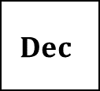
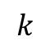
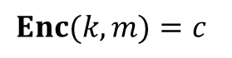
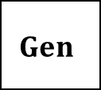
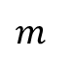
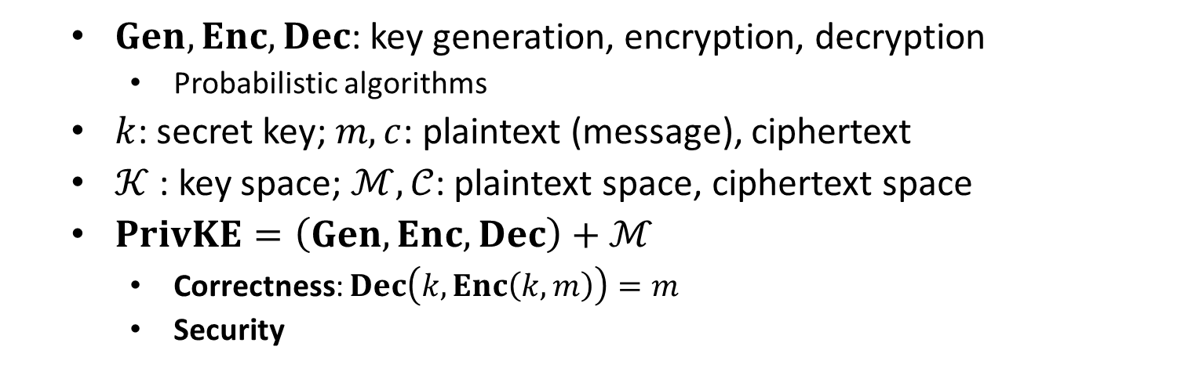
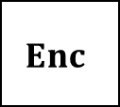
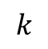
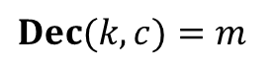
Private-Key Encryption
$$m$$
$$Enc$$
$$Enc(k, m)=c$$
$$Dec$$
Alice
Bob
$$k$$
$$k$$
$$Dec(k, c)=m$$
$$Gen$$
$Gen, Enc, Dec$: key generation, encryption, decryption
Probabilistic algorithms
$k$: secret key; $m, c$: plaintext (message), ciphertext
$𝒦$ : key space; $ℳ,𝒞$: plaintext space, ciphertext space
$PrivKE=\left(Gen, Enc, Dec\right)+ℳ$
Correctness: $Dec\left(k,Enc\left(k,m\right)\right)=m$
Security

Slide 5
Shift Cipher
SCHEME: $𝒦=\left\{0,…,25\right\},\left\{a,b,…,z\right\}↔𝒦, \{A,B,…,Z\}↔𝒦$
$Gen$: choose $k←\{0, 1,…, 25\}$ and output $k$
$Enc(k,m)$: output $c=(m+k) mod 26$
The above encryption is done for $m∈\{a,b,…,z\}$
The encryption is extended to $ℳ={\left\{a,b,…,z\right\}}^{∗}$
$Dec(k,c)$: output $(c−k) mod 26$
EXAMPLE: verify the correctness of shift cipher
$Enc\left(7,attack\right)=HAAHJR$; $Dec\left(7, HAAHJR\right)=attack$
∙∙∙∙∙∙
$$x$$
$$y$$
$$z$$
$$a$$
$$b$$
$$c$$
∙∙∙∙∙∙
$$u$$
∙∙∙∙∙∙
∙∙∙∙∙∙
$$E$$
$$F$$
$$G$$
$$H$$
$$I$$
$$J$$
∙∙∙∙∙∙
$$B$$
∙∙∙∙∙∙
$$k=7$$

Slide 6
Security
Attack: Try all secret keys until a meaningful plaintext appears
$Dec\left(0,HAAHJR\right)=haahjr$ $Dec\left(4,HAAHJR\right)=dwwdfn$
$Dec\left(1,HAAHJR\right)=gzzgiq$ $Dec\left(5,HAAHJR\right)=cvvcem$
$Dec\left(2,HAAHJR\right)=fyyfhp$ $Dec\left(6,HAAHJR\right)=buubdl$
$Dec\left(3,HAAHJR\right)=exxego$ $Dec\left(7,HAAHJR\right)=attack$
Brute-Force Attack: Try all possible secret keys and find the one
used for encryption
Exhaustive Search
Sufficient Key Space Principle: Any secure encryption scheme must
have a key space that is sufficiently large to make an exhaustive
search attack infeasible.
$|𝒦|$ must be large enough to thwart brute-force attack

Slide 7
Substitution Cipher
SCHEME: $𝒦=$the set of all bijections $σ:\left\{a,b,…,z\right\}→\left\{A,B,…,Z\right\}$
$Gen$: choose $σ←𝒦$ and output $σ$
$Enc(σ,m)$: output $c=σ(m)$
The above encryption is done for $m∈\{a,b,…,z\}$
The encryption is extended to ${ℳ=\left\{a,b,…,z\right\}}^{∗}$
$Dec(σ,c)$: output $m=σ^{−1}(c)$
EXAMPLE: encrypt the message $tell him about me$
Secret key $σ$ is the following bijection
$Enc\left(σ,tellhimaboutme\right)=GDOOKVCXEFLGCD$
$Dec\left(σ,GDOOKVCXEFLGCD\right)=tellhimaboutme$
$$a$$ | $$b$$ | $$c$$ | $$d$$ | $$e$$ | $$f$$ | $$g$$ | $$h$$ | $$i$$ | $$j$$ | $$k$$ | $$l$$ | $$m$$ | $$n$$ | $$o$$ | $$p$$ | $$q$$ | $$r$$ | $$s$$ | $$t$$ | $$u$$ | $$v$$ | $$w$$ | $$x$$ | $$y$$ | $$z$$
$$X$$ | $$E$$ | $$U$$ | $$A$$ | $$D$$ | $$N$$ | $$B$$ | $$K$$ | $$V$$ | $$M$$ | $$R$$ | $$O$$ | $$C$$ | $$Q$$ | $$F$$ | $$S$$ | $$Y$$ | $$H$$ | $$W$$ | $$G$$ | $$L$$ | $$Z$$ | $$I$$ | $$J$$ | $$P$$ | $$T$$

Slide 8
Vigenère Cipher
SCHEME: designed in 1600s, broken in 1860s, in order to defeat LFA
$𝒦=ℳ={\left\{a, b,…, z\right\}}^{∗} , 𝒞={\left\{A,B,…,Z\right\}}^{∗}$
$\left\{a, b,…, z\right\}↔\left\{0,1,…,25\right\}↔\{A,B,…,Z\}$
$Gen$: $k←{\left\{a,b,…,z\right\}}^{∗},$ say $k=k_{0}⋯k_{t−1}$
$Enc(k,m)$: $m=m_{0}m_{1}⋯m_{D−1}$
$m=m_{0}⋯m_{t−1}|| m_{t}⋯m_{2t−1}||⋯||m_{dt}⋯m_{D−1}$
$c_{i}=$ the letter obtained by shifting $m_{i}$ forward $k_{i mod t}$ positions
$c=c_{0}c_{1}⋯c_{D−1}$
$Dec$: Reverse the process.
REMARKs:
Large key space: infinite in theory
Same letter can be mapped to different ones

Slide 9
Classical & Modern Cryptography
All historical ciphers have been BADLY broken
The adversary learns only one ciphertext
The adversary can recover both the message and the secret key
Lessons of Classical Cryptography: it is like an art, not a science
Don’t tell us how secure a given system is
Don’t prove that a given system is secure
Principles of Modern Cryptography (a science)
Formal Definitions of Security
Precise Assumptions
Proofs of Security

Slide 10
Perfect Secrecy
DEFINITION: $Π=\left(Gen, Enc, Dec\right)+ℳ$ is perfectly secret if for any
distribution $M$, any $m∈ℳ,$ and any $c∈𝒞$with $\operatorname{Pr}\left[C=c\right]>0$
$$\operatorname{Pr}\left[M=m | C=c\right]=Pr⁡[M=m]$$
This kind of security requires that $M,C$ are independent
For simplicity, we always assume that $\operatorname{Pr}\left[C=c\right]>0$ for any $c$
Threat Model: (1) The adversary has unlimited computational power;
(2) The adversary observes only one ciphertext
Security Guarantee: The adversary learns no additional information
about $m$ from $c$, i.e., $\operatorname{Pr}\left[M=m | C=c\right]=Pr⁡[M=m]$.

Slide 11
Perfect Indistinguishability
Let $Π=\left(Gen, Enc, Dec\right)+ℳ$ be a private-key encryption. Define an
adversarial indistinguishability experiment $PrivK_{𝒜, Π}^{eav}$
choose $m_{0}, m_{1}∈ ℳ$
$$m_{0},m_{1}$$
$$k←Gen$$
$$b←\{0,1\}$$
$$Challenger$$
$$c←Enc(k,m_{b})$$
$$c$$
$$Adversary 𝒜$$
$$b′$$
$$PrivK_{𝒜, Π}^{eav}=\left\{\begin{aligned}0 b^{′}≠b \\ 1 b^{′}=b\end{aligned}\right.$$
DEFINITION: $Π$is perfectly indistinguishable if for every adversary $𝒜$,
$$\operatorname{Pr}\left[PrivK_{𝒜, Π}^{eav}=1\right]=1/2$$

Slide 12
One-Time Pad
SCHEME: $𝒦={\left\{0,1\right\}}^{n}, ℳ={\left\{0,1\right\}}^{n}, 𝒞={\left\{0,1\right\}}^{n}$
$k←Gen$: choose $k←{\left\{0,1\right\}}^{n}$ and output $k$
$c←Enc(k,m)$: output $c=k⊕m$
$Dec(k,c)$: output $k⊕c$
$⊕:$ the XOR operator-$0⊕0=1⊕1=0;0⊕1=1⊕0=1$
same as the operation $mod 2$
$\left(k_{1}⋯k_{n}\right)⊕\left(m_{1}⋯m_{n}\right)=\left(k_{1}⊕m_{1}\right)⋯(k_{n}⊕m_{n})$
EXAMPLE: $n=3, k=111, m=101$
encryption: $c=k⊕m=010$
decryption: $k⊕c=101$
REMARKs: proposed by Vernam in 1917 (a.k.a. Vernam’s Cipher)
perfectly secret (proved by Shannon in 1942)
the Red phone between White house and Kremlin

Slide 13
One-Time Pad
THEOREM: One-time pad is perfectly secret.
$\operatorname{Pr}\left[C=c | M=m\right]=\operatorname{Pr}{[K⊕m=c]}=Pr⁡[K=m⊕c]=2^{−n}$
$\operatorname{Pr}\left[C=c | M=m^{′}\right]=\operatorname{Pr}{[K⊕m′=c]}=Pr⁡[K=m′⊕c]=2^{−n}$
$\operatorname{Pr}\left[C=c | M=m\right]=\operatorname{Pr}\left[C=c | M=m′\right]$
REMARKs: the one-time pad has many drawbacks
long secret key: the secret key is as long as the message, i.e., $\left|k\right|=\left|m\right|$
Kerckhoffs: It must be possible to communicate and remember the
key without using written notes, and correspondents must be able
to change or modify it at will.
one-time security: the same secret key cannot be used more than once
$c=k⊕m, c^{′}=k⊕m^{′}⇒m⊕m^{′}=c⊕c′$
VENONA project: Soviet Union’s repeated use of OTP

Slide 14
Limitations
THEOREM: If $Π=\left(Gen, Enc, Dec\right)+ℳ$ is a perfectly secret encryption
scheme with key space $𝒦$, then $|𝒦|≥|ℳ|$.
Suppose that $\left|𝒦\right|<|ℳ|$. We deduce a contradiction.
$∀k∈𝒦, \left\{Enc\left(k,m\right):m∈ℳ\right\}⊆𝒞⇒\left|𝒞\right|≥\left|ℳ\right|>|𝒦|$
$∀ c∈𝒞,$ define $ℳ_{c}=\left\{Dec\left(k,c\right):k∈𝒦\right\}⊆ℳ$
$\left|ℳ_{c}\right|≤\left|𝒦\right|<\left|ℳ\right|⇒∃m∈ℳ∖ℳ_{c}$
Consider the uniform distribution $M$ over $ℳ$
$\operatorname{Pr}\left[M=m\right]=1/\left|ℳ\right|>0$
$\operatorname{Pr}\left[M=m | C=c\right]=0$
REMARKs: If $𝒦={\left\{0,1\right\}}^{n}$ and $ℳ={\left\{0,1\right\}}^{n^{′}},$then in a perfectly secret
encryption scheme we must have that $n≥n^{′}$.
The secret key must be as long as the message.
Main drawback of perfectly secure encryption.

Slide 15
Computational Security
Compromise: what we have to allow for a practical PrivKE scheme
The adversary’s computational power should be bounded.
Principle of Computational Security (Kerckhoffs): A cipher must be practically, if not mathematically, indecipherable
The adversary is allowed to succeed with an additional small probability.
As long as the probability is small enough, the adversary will not succeed, except it tries for an infeasible number of times.
Computational Security: A private-key encryption is secure if
The adversary is computationally bounded (efficient) and runs for some feasible amount of time; and
The adversary can potentially succeed with very small probability
How to Define Computational Security?
Concrete Approach; Asymptotic Approach

Slide 16
Concrete Approach
Methodology: (1) Bound the running time of the adversary; (2) Bound
the success probability of the adversary.
The Approach: A scheme is $(t,ε)$-secure if any adversary with running
time $≤t$ can succeed in breaking the scheme with probability $≤ε$
EXAMPLE: a private-key encryption that cannot be broken with attacks
of some type with probability $2^{−60}$ in $200$ years using the fastest
computer available today is considered as secure.
The concrete approach is important in practice
It is difficult to work with

Slide 17
Asymptotic Approach
Methodology:
Introduce a security parameter $n$ (e.g., bit length of secret key)
Adversary: probabilistic polynomial time algorithm
Success probability: negligible function of $n$
The Approach: A scheme is secure if any PPT adversary can succeed in
breaking the scheme with at most negligible probability
EXAMPLE: A scheme is secure if for any PPT adversary $𝒜$ carrying out
some an attack of some formally specified type, the probability that
$𝒜$ succeeds in the attack is negligible.
Specified type: COA, KPA, CPA, CCA

Slide 18
PPT and Negligible
Polynomial-Time Algorithms: $A$ is a polynomial-time algorithm if there
is a polynomial $p(⋅)$ such that $∀x∈{\left\{0,1\right\}}^{∗}$, the running time of $A(x)$
is $≤p(|x|)$.
PPT: probabilistic polynomial-time
Negligible: A function $f:ℕ→ℝ_{≥0}$ is negligible if $∀$ polynomial function
$p\left(⋅\right)>0$, there exists $N$ such that $f\left(n\right)<1/p\left(n\right)$ when $n>N.$
$f\left(n\right)=2^{−n}, 2^{−\sqrt{n}}, n^{−\log{n}}$ are all negligible functions
$f\left(n\right)=\frac{1}{n^{10000}}, n^{\log{\log{n}/\log{n}}}$are non-negligible
THEOREM: Let $f\left(n\right), g\left(n\right)$ be negligible and let $p(n)$ be a polynomial.
Then $f\left(n\right)+g\left(n\right), p\left(n\right)⋅f(n)$ are both negligible.

Slide 19
IND-EAV
Let $Π=\left(Gen, Enc, Dec\right)+ℳ$ be a private-key encryption. Define an
adversarial indistinguishability experiment $PrivK_{𝒜, Π}^{eav}(n)$
choose $m_{0}, m_{1}∈ ℳ$
with $\left|m_{0}\right|=|m_{1}|$
$$m_{0},m_{1}$$
$$k←Gen\left(1^{n}\right)$$
$$b←\{0,1\}$$
$$Challenger$$
$$c←Enc(k,m_{b})$$
$$Adversary 𝒜$$
$$c$$
$$b′$$
$$PrivK_{𝒜, Π}^{eav}(n)=\left\{\begin{aligned}0 b^{′}≠b \\ 1 b^{′}=b\end{aligned}\right.$$

Slide 20
OTP is IND-EAV
$$m_{0},m_{1}$$
choose $m_{0}, m_{1}∈{\left\{0,1\right\}}^{n}$
$$k←{\left\{0,1\right\}}^{n}$$
$$c←k⊕m_{0}$$
$$Adversary 𝒜$$
$$Challenger$$
$$c$$
$$b^{′}$$
$$m_{0},m_{1}$$
choose $m_{0}, m_{1}∈{\left\{0,1\right\}}^{n}$
$$k←{\left\{0,1\right\}}^{n}$$
$$Challenger$$
$$c←k⊕m_{1}$$
$$Adversary 𝒜$$
$$c$$
$$b^{′}$$
$$k⊕m_{0}≡k⊕m_{1}$$
$$\operatorname{Pr}\left[{out}_{𝒜}(PrivK_{𝒜, OTP}^{eav}\left(n,0\right))=1\right] =\operatorname{Pr}\left[{out}_{𝒜}(PrivK_{𝒜, OTP}^{eav}\left(n,1\right))=1\right]$$

Slide 21
Statistical Distance
DEFINITION: Let $R$ be a finite or countable set. Let $X,Y$ be two random
variables that take values in $R$. The statistical distance between $X$
and $Y$ is defined as $SD\left(X,Y\right)=\frac{1}{2}\sum_{r∈R}{\left|\operatorname{Pr}\left[X=r\right]−\operatorname{Pr}\left[Y=r\right]\right| }$.
EXAMPLE: Compute $SD(X,Y)$ for the random variables $X,Y$, which take
values in $R={\left\{0,1\right\}}^{n}$ and defined as below:
$X:$ $\operatorname{Pr}\left[X=0^{n}\right]=0,\operatorname{Pr}\left[X=r\right]=\frac{1}{2^{n}−1}$ for all $r∈{\left\{0,1\right\}}^{n}\backslash 0^{n}$
$Y:$ $\operatorname{Pr}\left[Y=r\right]=\frac{1}{2^{n}}$ for every $r∈{\left\{0,1\right\}}^{n}$
$SD\left(X,Y\right)=\frac{1}{2}\sum_{r∈{\left\{0,1\right\}}^{n}}{|\operatorname{Pr}\left[X=r\right]−Pr⁡[Y=r]|}$
$=\frac{1}{2}\left(\left|0−\frac{1}{2^{n}}\right|+\left(2^{n}−1\right)\left|\frac{1}{2^{n}−1}−\frac{1}{2^{n}}\right|\right)$
$=\frac{1}{2^{n}}$

Slide 22
Computational Indistinguishability
DEFINITION: Let $X_{n},Y_{n}$ be random variables for $n=1,2,3,…$ We call
$X=\left\{X_{n}\right\}, Y=\{Y_{n}\}$ probability ensembles. $X$ and $Y$ are said to be
computationally indistinguishable (c.i.) if for any PPT distinguisher
D, there is a negligible function $negl(n)$ s.t.
$|\operatorname{Pr}\left[𝒟\left(1^{n},X_{n}\right)=1\right]−Pr⁡[𝒟\left(1^{n},Y_{n}\right)=1]|≤negl(n)$
$1^{n}$ usually omitted
Notation: $X≡_{c.i.}Y$
EXAMPLE: Are the following probability ensembles c.i.?
$X={\left\{X_{n}\right\}}_{n≥1}, Y={\left\{Y_{n}\right\}}_{n≥1}$
$X_{n}:$ $\operatorname{Pr}\left[X_{n}=0^{n}\right]=0,\operatorname{Pr}\left[X_{n}=r\right]=\frac{1}{2^{n}−1}$ for all $r∈{\left\{0,1\right\}}^{n}\backslash 0^{n}$
$Y_{n}:$ uniformly random variable over ${\left\{0,1\right\}}^{n}$

Slide 23
Computational Indistinguishability
Analysis: Denote $δ_{n}=|\operatorname{Pr}\left[𝒟\left(X_{n}\right)=1\right]−Pr⁡[𝒟\left(Y_{n}\right)=1]|$
$δ_{n}=\left|\sum_{r∈{\left\{0,1\right\}}^{n}}{(\operatorname{Pr}\left[𝒟\left(r\right)=1\right]}\operatorname{Pr}\left[X_{n}=r\right]−\operatorname{Pr}\left[𝒟\left(r\right)=1\right]\operatorname{Pr}\left[Y_{n}=r\right]\right)|$
$≤\sum_{r∈{\left\{0,1\right\}}^{n}}{\operatorname{Pr}\left[𝒟\left(r\right)=1\right]}|\operatorname{Pr}\left[X_{n}=r\right]−\operatorname{Pr}\left[Y_{n}=r\right]|$
$≤2⋅SD\left(X_{n},Y_{n}\right)$
$=\frac{2}{2^{n}}$
$X, Y$ are computationally indistinguishable probability ensembles
THEOREM: If $SD\left(X_{n},Y_{n}\right)≤negl(n)$, then $X=\{X_{n}\}$ and $Y=\{Y_{n}\}$ are
computationally indistinguishable.
$X,Y$ are statistically indistinguishable: $SD\left(X_{n},Y_{n}\right)≤negl(n)$ for all $n$
Notation: $X≡_{s.i.}Y$
$X,Y$ are perfectly indistinguishable: $SD\left(X_{n},Y_{n}\right)=0$ for all $n$
Notation: $X≡_{p.i.}Y$

Slide 24
Computational Indistinguishability
THEOREM: $X≡_{p.i.}Y⇒X≡_{s.i.}Y⇒ X≡_{c.i.}Y.$
$SD\left(X_{n},Y_{n}\right)=0⇒SD\left(X_{n},Y_{n}\right)≤negl\left(n\right)⇒X≡_{c.i.}Y$
We say that $p.i. ⇒s.i. ⇒c.i.$ (from strong to weak)
THEOREM: $X≡_{a}X$ for $a∈\{p.i., s.i., c.i.\}$
THEOREM: $X≡_{a}Y⇒Y≡_{a}X$ for $a∈\{p.i., s.i., c.i.\}$
$SD\left(X_{n},Y_{n}\right)=0⇒SD\left(Y_{n},X_{n}\right)=0$
$SD\left(X_{n},Y_{n}\right)≤negl\left(n\right)⇒SD\left(Y_{n},X_{n}\right)≤negl\left(n\right)$
$|\operatorname{Pr}\left[𝒟\left(X_{n}\right)=1\right]−Pr⁡[𝒟\left(Y_{n}\right)=1]|≤negl\left(n\right)⇒|\operatorname{Pr}\left[𝒟\left(Y_{n}\right)=1\right]−Pr⁡[𝒟\left(X_{n}\right)=1]|≤negl\left(n\right)$
THEOREM: $X≡_{a}Y, Y≡_{b}Z⇒X≡_{weak(a,b)}Z$, where
$weak\left(a,b\right)=\left\{\begin{aligned}a if b⇒a \\ b if a⇒b\end{aligned}\right.$ for all $a,b∈\{p.i., s.i., c.i.\}$.

Slide 25
Pseudorandomness
DEFINITION: Let $X=\left\{X_{n}\right\}$be a probability ensemble, where the $X_{n}$ is
distributed over ${\left\{0,1\right\}}^{n}$. Let $U_{n}$ be uniformly distributed over ${\left\{0,1\right\}}^{n}$.
The probability ensemble $X$ is said to be pseudorandom if
$X$ and $U=\{U_{n}\}$ are computationally indistinguishable.
EXAMPLE: Let $X_{n}$ be a random variable over the set ${\left\{0,1\right\}}^{n}$ such that
$\operatorname{Pr}\left[X_{n}=0^{n}\right]=0, and \operatorname{Pr}\left[X_{n}=r\right]=\frac{1}{2^{n}−1}$ for all $r∈{\left\{0,1\right\}}^{n}\backslash 0^{n}$.
$SD\left(X_{n},U_{n}\right)=2^{−n}$ //$U_{n}$ is the uniform distribution
$X_{n}$ and $U_{n}$ are computationally indistinguishable
$X=\{X_{n}\}$ is pseudorandom
Use $X_{n}$ instead of $U_{n}$ in OTP?
denote the new scheme by $OTP^{′}$
Is $OTP^{′}$ IND-EAV secure?

Slide 26
IND-EAV from Pseudorandomness
$$m_{0},m_{1}$$
$$m_{0},m_{1}$$
$$k←X_{n}$$
$$k←{\left\{0,1\right\}}^{n}$$
$$c_{1}=k⊕m_{0}$$
$$c_{1}$$
$${c_{1}≡}_{s.i.}c_{2}$$
$$c_{2}=k⊕m_{0}$$
$$c_{2}$$
$$b^{′}$$
$$b^{′}$$
challenger
$$𝒜$$
challenger
$$𝒜$$
$${c_{1}≡}_{s.i.}c_{4}$$
$$c_{2}≡_{p.i.}c_{3}$$
$$m_{0},m_{1}$$
$$m_{0},m_{1}$$
$$k←X_{n}$$
$$k←{\left\{0,1\right\}}^{n}$$
$$c_{4}=k⊕m_{1}$$
$$c_{4}$$
$${c_{4}≡}_{s.i.}c_{3}$$
$$c_{3}=k⊕m_{1}$$
$$c_{3}$$
$$b^{′}$$
$$b^{′}$$
challenger
$$𝒜$$
challenger
$$𝒜$$
IND-EAV secure
$\left|k\right|=\log_{2}{(2^{n}−1)}<n$ bits
$$PrivK_{𝒜, OTP^{′}}^{eav}\left(n,b\right)$$
$$PrivK_{𝒜, OTP}^{eav}\left(n,b\right)$$

Slide 27
Pseudorandom Generator (PRG)
DEFINITION: A function $G:{\left\{0,1\right\}}^{n}→{\left\{0,1\right\}}^{l(n)}$ is called a pseudorandom
generator (PRG) if it satisfies the following conditions:
efficiently computable: there is a deterministic polynomial-time algorithm $D$ such that $D\left(x\right)=G(x)$ for all $x∈{\left\{0,1\right\}}^{n}$
expansion: $l\left(n\right)>n$ for all $n∈ℕ$
$l$is called the expansion factor of $G$
pseudorandomness: $G(U_{n})$ is pseudorandom, where $U_{n}$ is uniformly distributed over ${\left\{0,1\right\}}^{n}$
$∀$ PPT algorithm $𝒟$, $∃$ a negligible function $negl(⋅)$ s.t.
$|Pr⁡[𝒟\left(G\left(U_{n}\right)\right)=1]−Pr⁡[𝒟\left(U_{l(n)}\right)=1]|≤negl(n)$

Slide 28
Fixed-Length Encryption from PRG
Idea: How to construct an IND-EAV encryption scheme using PRG?
OTP: $c=k⊕m$, where the key $k$ is uniform over ${\left\{0,1\right\}}^{n}$
Limitation: the key $k$ is as long as the message
PRG: generate a key $k=G(s)$, which is pseudorandom but $\left|s\right|≪|k|$
SCHEME: $Π=\left(Gen, Enc, Dec\right)+ℳ$
$G:{\left\{0,1\right\}}^{n}→{\left\{0,1\right\}}^{l(n)}$is a PRG.
$𝒦={\left\{0,1\right\}}^{n}, ℳ=𝒞={\left\{0,1\right\}}^{l(n)}$
$Gen\left(1^{n}\right):$ choose $k←{\left\{0,1\right\}}^{n}$ and output $k$
$Enc\left(k,m\right):$ output $c=G\left(k\right)⊕m$
$Dec\left(k,c\right):$ output $G\left(k\right)⊕c$
Correctness: $∀k∈𝒦={\left\{0,1\right\}}^{n}, m∈ℳ={\left\{0,1\right\}}^{l(n)},$
$Dec\left(k,Enc\left(k,m\right)\right)=G\left(k\right)⊕\left(G\left(k\right)⊕m\right)=m$

Slide 29
One-Way Function
The Inverting Experiment $Invert_{𝒜,f}\left(n\right)$ for $f:{\left\{0,1\right\}}^{∗}→{\left\{0,1\right\}}^{∗}$
$$x←{\left\{0,1\right\}}^{n}$$
$$y=f(x)$$
$$y$$
$$x′$$
$$Challenger$$
$$Invert_{𝒜,f}\left(n\right)=$$
$\left\{\begin{aligned}1, f\left(x^{′}\right)=y \\ 0, f\left(x^{′}\right)≠y\end{aligned}\right.$
$$Adversary 𝒜$$
DEFINITION: $f:{\left\{0,1\right\}}^{∗}→{\left\{0,1\right\}}^{∗}$ is a one-way function (OWF) if
easy to compute: $∃$ DPT $C$ s.t. $C\left(x\right)=f\left(x\right), ∀x∈{\left\{0,1\right\}}^{∗}$
hard to invert: $∀$ PPT $𝒜, ∃$a negligible function $negl(⋅)$ s.t.
$$\operatorname{Pr}\left[Invert_{𝒜,f}\left(n\right)=1\right]≤negl(n)$$
One-way permutation (OWP): $f:{\left\{0,1\right\}}^{n}→{\left\{0,1\right\}}^{n}$ is bijective for all $n$
EXAMPLE: $f_{p,g}\left(x\right)=g^{x} mod p$ is conjectured as a OWP.
$p$ is a prime, $g$ is a generator of $ℤ_{p}^{∗}$, $x∈\{1,2,…,p−1\}$

Slide 30
Hard-Core Predicate
DEFINITION: Let $f:{\left\{0,1\right\}}^{∗}→{\left\{0,1\right\}}^{∗}and hc:{\left\{0,1\right\}}^{∗}→\{0,1\}$ be two
functions. $hc$ is a hard-core predicate (HCP) for $f$ if
easy to compute: $∃$ DPT $C$ s.t. $C\left(x\right)=hc(x)$ for every $x∈{\left\{0,1\right\}}^{∗}$
hard to predicate: $∀$PPT $𝒜, ∃$ a negligible function $negl(⋅)$ s.t.
$$\underset{x←{\left\{0,1\right\}}^{n}}{Pr}{[𝒜\left(1^{n}, f\left(x\right)\right)=hc(x)]}≤\frac{1}{2}+negl(n)$$
Goldreich-Levin Theorem: Assume that OWFs (OWPs) exist. Then there
is a OWF (OWP) $g$ and a hard-core predicate $hc$ for $g$.
THEOREM: Let $f$ be a OWP and let $hc(x)$ be a hard-core predicate for $f$.
Then $G\left(x\right)=\left(f\left(x\right),hc\left(x\right)\right):{\left\{0,1\right\}}^{n}→{\left\{0,1\right\}}^{n+1}$ is a PRG.

Slide 31
PRG with Arbitrary Expansion
CONSTRUCTION: repeatedly apply the HCP-PRG on the $n$-bit prefix
$f:{\left\{0,1\right\}}^{∗}→{\left\{0,1\right\}}^{∗}$ is a OWP; $hc:{\left\{0,1\right\}}^{∗}→\{0,1\}$ is a HCP for $f$
$G\left(x\right)=(f\left(x\right),hc\left(x\right))$ is a PRG with $l\left(n\right)=n+1$
$G′:{\left\{0,1\right\}}^{n}→{\left\{0,1\right\}}^{n+p\left(n\right)} x↦G′(x)$
$$G′\left\{\begin{aligned} \\ \\ \\ \\ \\ \\ \\ \\ \\ \end{aligned}\right.$$
$$x$$
$$hc(x)$$
$$x$$
$$G↓$$
$$f(x)$$
$$hc(f(x))$$
$$hc(x)$$
$$G↓$$
$$f(f(x))$$
$$⋮$$
$$⋮$$
$$hc(f^{(p\left(n\right)−1)}(x))$$
$$f^{(p\left(n\right))}(x)$$
$$⋯⋯$$
$$G′(x)$$
$n$ bits
$p(n)$ bits
THEOREM: The function $G′$ is a PRG with expansion factor $n+p(n)$.

Slide 32
Stream Cipher
DEFINITION: A stream cipher $Π=(Init , GetBits)$ works as follows:
INPUT: a seed$s$and an optional initialization vector $IV$
OUTPUT: pseudorandom bits $y_{1},…,y_{l}$
$st_{0}=Init(s,IV)$
$for i=1 to l do$
$\left(y_{i}, st_{i}\right)←GetBits(st_{i−1})$
$return y_{1},…,y_{l}$
Application: constructing IND-EAV encryption scheme
Use the generated pseudorandom bits to encrypt messages
$$s$$
$$Init$$
$$st_{0}$$
$$GetBits$$
$$st_{1}$$
$$GetBits$$
$$st_{2}$$
$$GetBits$$
$$st_{3}$$
$$IV$$
$$⋯$$
$$y_{1}$$
$$y_{2}$$
$$y_{3}$$
$$⋯$$

Slide 33
IND-m-EAV
Let $Π=\left(Gen, Enc, Dec\right)+ℳ$ be a private-key encryption. Define an
multiple-message eavesdropping experiment $PrivK_{𝓐, Π}^{mult}(n)$
choose $M_{0}=(m_{0,1},…,m_{0,t})$
choose $M_{1}=\left(m_{1,1},…,m_{1,t}\right)$
$\left|m_{0,i}\right|=\left|m_{1,i}\right|, ∀ i$
$$M_{0},M_{1}$$
$$k←Gen\left(1^{n}\right)$$
$$Challenger$$
$$b←\{0,1\}$$
$$Adversary 𝒜$$
$$c_{i}←Enc(k,m_{b,i})$$
$$C=(c_{1},…,c_{t})$$
$$b′$$
$$PrivK_{𝒜, Π}^{mult}(n)=\left\{\begin{aligned}0 b^{′}≠b \\ 1 b^{′}=b\end{aligned}\right.$$
$t$: can be any polynomial function in $n;$ chosen by the adversary

Slide 34
$$\text{Chosen}\text{−}\text{Plaintext} \text{Attack}$$
$Enc\left(k,⋅\right):$given an message $m∈ℳ$, output $c←Enc(k,m)$
CPA indistinguishability experiment $PrivK_{𝒜, Π}^{cpa}(n)$
$$k←Gen\left(1^{n}\right)$$
$$oracle access to$$
$$Enc\left(k,⋅\right)$$
$$m_{0},m_{1}$$
$$\left|m_{0}\right|=|m_{1}|$$
$$Challenger$$
$$b←\{0,1\}$$
$$Adversary 𝒜$$
$$c←Enc(k,m_{b})$$
$$c$$
$$oracle access to$$
$$Enc\left(k,⋅\right)$$
$$b′$$
$$PrivK_{𝒜, Π}^{cpa}(n)=\left\{\begin{aligned}0 b^{′}≠b \\ 1 b^{′}=b\end{aligned}\right.$$
The number of oracle access can be any polynomial function in $n$
Determined by the adversary

Slide 35
IND-m-CPA
$LR_{k,b}\left(⋅\right):$given $m_{0},m_{1}∈ℳ$, output $c←Enc(k,m_{b})$
LR-Oracle experiment $PrivK_{𝒜, Π}^{LR−cpa}(n)$
$$k←Gen\left(1^{n}\right)$$
$$b←\{0,1\}$$
$$oracle access to$$
$$LR_{k,b}(⋅)$$
$$Challenger$$
$$Adversary 𝒜$$
$$b′$$
$$PrivK_{𝒜, Π}^{LR−cpa}\left(n\right)=\left\{\begin{aligned}0 b^{′}≠b \\ 1 b^{′}=b\end{aligned}\right.$$
The number of oracle access can be any polynomial function in $n$
Determined by the adversary

Slide 36
Security Definitions
Perfect Secrecy
Perfect Indistinguishability
IND-EAV
IND-m-EAV
IND-CPA
IND-m-CPA

Slide 37
From Fixed-Length to Arbitrary-Length
CONSTRUCTION: $Π′=\left(Gen^{′}, Enc^{′}, Dec^{′}\right)+ℳ′$
Building Block: $Π=\left(Gen, Enc, Dec\right)+ℳ$ is IND-CPA secure.
$Gen^{′}\left(1^{n}\right):$ output $k←Gen(1^{n})$
$Enc^{′}\left(k,m\right):m=m_{1}m_{2}⋯m_{t}∈ℳ^{t}$
$c_{i}=Enc(k,m_{i})$ for every $i∈[t]$
output $c=c_{1}c_{2}⋯c_{t}$
$Dec^{′}(k,c)$
$m_{i}=Dec(k,c_{i})$
output $m=m_{1}m_{2}⋯m_{t}$
THEOREM: If $Π$ is IND-CPA secure, then $Π^{′}$ is also IND-CPA secure.
If $Π$ is IND-m-CPA secure, then $Π^{′}$ is also IND-m-CPA secure

Slide 38
PRF
DEFINITION: Let $F:{\left\{0,1\right\}}^{∗}×{\left\{0,1\right\}}^{∗}→{\left\{0,1\right\}}^{∗}$ be an efficient, length-
preserving, keyed function. $F$ is said to be a PRF if for all PPT
algorithm $𝒟$, there is a negligible function $negl(⋅)$ such that
$$|\operatorname{Pr}\left[𝒟^{F_{k}\left(⋅\right)}=1\right]−Pr⁡[𝒟^{f\left(⋅\right)}=1]|≤negl(n)$$
The probabilities are taken over $k←{\left\{0,1\right\}}^{n}, f←Func_{n}$ and $𝒟$’s coins
QUESTION: use PRFs as encryption functions, i.e., $Enc\left(k,m\right)=F_{k}(m)?$
Not IND-m-EAV, not IND-CPA
$F_{k}$is deterministic
$$y_{i}=𝒪(x_{i})$$
$$𝒟$$
$$x_{1},x_{2},…,x_{q}$$
$$𝒪=F_{k} or f$$
$$b$$
$$y_{1},y_{2},…,y_{q}$$

Slide 39
IND-CPA from PRF
CONSTRUCTION: $Π=\left(Gen,Enc, Dec\right)+ℳ$
$F:$ a length-preserving PRF
$𝒦=ℳ={\left\{0,1\right\}}^{n}, 𝒞={\left\{0,1\right\}}^{2n}$ for a security parameter $n$
$Gen(1^{n})$:
choose $k←{\left\{0,1\right\}}^{n}$ and output $k$
$Enc\left(k,m\right):m∈{\left\{0,1\right\}}^{n}$
choose $r←{\left\{0,1\right\}}^{n}$ and output $c=(r,F_{k}\left(r\right)⊕m)$
$Dec\left(k,c\right):c=(r,s)$
output $s⊕F_{k}(r)$
REMARK: fixed-length, probabilistic encryption; $\left|c\right|>|m|$

Slide 40
PRF from PRG
CONSTRUCTION: Given a PRG $G$, construct a length-preserving PRF $F$
$G:{\left\{0,1\right\}}^{n}→{\left\{0,1\right\}}^{2n} G\left(k\right)=G_{0}\left(k\right)||G_{1}\left(k\right), \left|G_{0}\left(k\right)\right|=\left|G_{1}\left(k\right)\right|=n$ is a PRG
$F:{\left\{0,1\right\}}^{n}×{\left\{0,1\right\}}^{n}→{\left\{0,1\right\}}^{n}$ is defined as follows
$F\left(k,x\right)=G_{x_{n}}\left(G_{x_{n−1}}\left(⋯\left(G_{x_{2}}\left(G_{x_{1}}\left(k\right)\right)\right)⋯\right)\right)$
$$n=3$$
$$k$$
$$G_{0}$$
$$G_{1}$$
$$G_{0}(k)$$
$$G_{1}(k)$$
$$G_{0}$$
$$G_{1}$$
$$G_{0}$$
$$G_{1}$$
$$G_{0}$$
$$G_{1}$$
$$G_{0}$$
$$G_{1}$$
$$G_{0}$$
$$G_{1}$$
$$G_{0}$$
$$G_{1}$$
$$F_{k}(000)$$
$$F_{k}(001)$$
$$F_{k}(010)$$
$$F_{k}(011)$$
$$F_{k}(100)$$
$$F_{k}(101)$$
$$F_{k}(110)$$
$$F_{k}(111)$$

Slide 41
PRG from PRF
CONSTRUCTION: Given a length preserving PRF $F$, construct a PRG $G$
$F:{\left\{0,1\right\}}^{∗}×{\left\{0,1\right\}}^{∗}→{\left\{0,1\right\}}^{∗}$ is a length preserving PRF
Define $G:{\left\{0,1\right\}}^{n}→{\left\{0,1\right\}}^{ln}$ as $G\left(k\right)=F_{k}\left(1\right)||F_{k}(2)||⋯||F_{k}\left(l\right)$
The function $G$ define above is a PRG with expansion factor $ln$
Stream Cipher from PRF:
$F:{\left\{0,1\right\}}^{∗}×{\left\{0,1\right\}}^{∗}→{\left\{0,1\right\}}^{∗}$ is a length preserving PRF
$Π=(Init, GetBits)$
$Init\left(s,IV\right): st_{0}=\left(s,IV\right)$ // $IV=IV_{0}$
$GetBits(st_{i})$
$st_{i}=(s,IV_{i})$
$st_{i+1}=\left(s,IV_{i}+1\right), y=F_{s}(IV_{i}+1)$
output $st_{i+1}$ and $y$

Slide 42
PRP
DEFINITION: Let $F:{\left\{0,1\right\}}^{∗}×{\left\{0,1\right\}}^{∗}→{\left\{0,1\right\}}^{∗}$ be an efficient computable,
efficiently invertible, length-preserving, keyed permutation. $F$ is said
to be a pseudorandom permutation (PRP) if for all PPT algorithm $𝒟$,
there is a negligible function $negl(⋅)$ such that
$\left|\operatorname{Pr}\left[𝒟^{F_{k}\left(⋅\right)}=1\right]−\operatorname{Pr}\left[𝒟^{f\left(⋅\right)}=1\right]\right|≤negl(n)$,
where the probabilities are taken over $k←{\left\{0,1\right\}}^{n}$, $f←Perm_{n}$ and the randomness of $𝒟$.
$$y_{i}=𝒪(x_{i})$$
$$𝒟$$
$$x_{1},x_{2},…,x_{q}$$
$𝒪=F_{k}$ or $f$
$$b$$
$$y_{1},y_{2},…,y_{q}$$
THEOREM: If $F$ is a PRP and $l_{in}\left(n\right)≥n$, then $F$ is a PRF.

Slide 43
Strong PRP (Block Cipher)
DEFINITION: Let $F:{\left\{0,1\right\}}^{∗}×{\left\{0,1\right\}}^{∗}→{\left\{0,1\right\}}^{∗}$ be an efficient computable,
efficiently invertible, length-preserving, keyed permutation. $F$ is said
to be a strong pseudorandom permutation (sPRP) if for all PPT
algorithm $𝒟$, there is a negligible function $negl(⋅)$ such that
$\left|\operatorname{Pr}\left[𝒟^{F_{k}\left(⋅\right),F_{k}^{−1}(⋅)}=1\right]−\operatorname{Pr}\left[𝒟^{f\left(⋅\right),f^{−1}(⋅)}=1\right]\right|≤negl(n)$
where the probabilities are taken over $k←{\left\{0,1\right\}}^{n}$, $f←Perm_{n}$ and the randomness of $𝒟$.
$$y_{i}=𝒪(x_{i})$$
$$x_{1},x_{2},…,x_{q}$$
$$𝒟$$
$$y_{1},y_{2},…,y_{q}$$
$𝒪=F_{k}$ or $f$
$$b$$
$$x_{i}^{′}=𝒪^{−1}(y_{i}^{′})$$
$$y_{1}^{′},y_{2}^{′},…,y_{q^{′}}^{′}$$
$$x_{1}^{′},x_{2}^{′},…,x_{q^{′}}^{′}$$

Slide 44
PRP from PRF
CONSTRUCTION: $F$- a length-preserving PRF
$P:{\left\{0,1\right\}}^{3n}×{\left\{0,1\right\}}^{2n}→{\left\{0,1\right\}}^{2n}$
Key: $k=\left(k_{1}, k_{2}, k_{3}\right)∈{\left({\left\{0,1\right\}}^{n}\right)}^{3}$
Input: $x=L_{0}||R_{0}∈{\left({\left\{0,1\right\}}^{n}\right)}^{2}$
Output: $y=L_{3}||R_{3}∈{\left({\left\{0,1\right\}}^{n}\right)}^{2}$
$L_{1}=R_{0}, R_{1}=L_{0}⊕F_{k_{1}}(R_{0})$
$L_{2}=R_{1}, R_{2}=L_{1}⊕F_{k_{2}}(R_{1})$
$L_{3}=R_{2}, R_{3}=L_{2}⊕F_{k_{3}}(R_{2})$
THEOREM: if $F$ is a PRF, then $P$ is a PRP.
Replace $F_{k_{i}}$ with $f_{i}$ for $i=1,2,3$ in the 3-round Feistel network
Collision at $R_{1}$ negligible; Collision at $R_{2}$ negligible
If no collisions, $(L_{3},R_{3})$ is computationally indistinguishable from the
output of truly random permutation
$$L_{0}$$
$$R_{0}$$
$$⨁$$
$$F_{k_{1}}$$
$$L_{1}$$
$$R_{1}$$
$$⨁$$
$$F_{k_{2}}$$
$$L_{2}$$
$$R_{2}$$
$$⨁$$
$$F_{k_{3}}$$
$$L_{3}$$
$$R_{3}$$

Slide 45
Strong PRP from PRF
CONSTRUCTION: $F$- a length-preserving PRF
$P:{\left\{0,1\right\}}^{4n}×{\left\{0,1\right\}}^{2n}→{\left\{0,1\right\}}^{2n}$
Key: $k=\left(k_{1}, k_{2}, k_{3},k_{4}\right)∈{\left({\left\{0,1\right\}}^{n}\right)}^{4}$
Input: $x=L_{0}||R_{0}∈{\left({\left\{0,1\right\}}^{n}\right)}^{2}$
Output: $y=L_{4}||R_{4}∈{\left({\left\{0,1\right\}}^{n}\right)}^{2}$
$L_{1}=R_{0}, R_{1}=L_{0}⊕F_{k_{1}}(R_{0})$
$L_{2}=R_{1}, R_{2}=L_{1}⊕F_{k_{2}}(R_{1})$
$L_{3}=R_{2}, R_{3}=L_{2}⊕F_{k_{3}}(R_{2})$
$L_{4}=R_{3}, R_{4}=L_{3}⊕F_{k_{4}}(R_{3})$
THEOREM: if $F$ is a PRF, then $P$ is a strong PRP.
M. Luby and C. Rackoff. How to construct pseudorandom permutations
from pseudorandom functions. SIAM J. Computing, 17(2):373–386, 1988.
$$L_{0}$$
$$R_{0}$$
$$⨁$$
$$F_{k_{1}}$$
$$L_{1}$$
$$R_{1}$$
$$⨁$$
$$F_{k_{2}}$$
$$L_{2}$$
$$R_{2}$$
$$⨁$$
$$F_{k_{3}}$$
$$L_{3}$$
$$R_{3}$$
$$⨁$$
$$F_{k_{4}}$$
$$L_{4}$$
$$R_{4}$$

Slide 46
Modes of Operation
Modes of Operations: encrypting the message such that $\left|c\right|≈|m|$
ECB: Electronic Code Book mode
CBC: Cipher Block Chaining mode
OFB: Output Feedback mode
CTR: Counter mode
Padding Technique: $F$ is a block cipher with block length $n$ ($l_{in}=n$)
The length of the message $m$ is not a multiple of $n$
Append $10⋯0$ at the end of $m$ such that $n divides |m10⋯0|$
The length of the message $m$ is a multiple of $n$
Append $10⋯0$ of $n$ bits
REMARK: Wlog, the length of the message is a multiple of $n$

Slide 47
ECB
CONSTRUCTION: $F$ is a block cipher with block length $n$
$Gen(1^{n})$: choose $k←{\left\{0,1\right\}}^{n}$ and output $k$
$Enc(k,m)$: $m∈{\left\{0,1\right\}}^{tn}$ and $m=m_{1}⋯m_{t}$
$c=F_{k}\left(m_{1}\right)||F_{k}\left(m_{2}\right)||⋯||F_{k}(m_{t})$
$Dec(k,c)$: $c∈{\left\{0,1\right\}}^{tn}$ and $c=c_{1}⋯c_{t}$
output $F_{k}^{−1}\left(c_{1}\right)||F_{k}^{−1}\left(c_{2}\right)||⋯||F_{k}^{−1}(c_{t})$
Analysis:
Deterministic and thus not IND-CPA secure
Not IND-EAV secure
Should never be used in practice
$$m_{1}$$
$$m_{2}$$
$$m_{3}$$
$$F_{k}$$
$$F_{k}$$
$$F_{k}$$
$$c_{1}$$
$$c_{2}$$
$$c_{3}$$

Slide 48
CBC
CONSTRUCTION: $F$ is a block cipher with block length $n$
$Gen(1^{n})$: choose $k←{\left\{0,1\right\}}^{n}$ and output $k$
$Enc(k,m)$: $m∈{\left\{0,1\right\}}^{tn}$ and $m=m_{1}⋯m_{t}$
$IV←{\left\{0,1\right\}}^{n}, c_{0}≔IV;$
$for i=1 to t do$
$c_{i}=F_{k}(c_{i−1}⊕m_{i})$
$c=c_{0}c_{1}⋯c_{t}$
$Dec(k,c)$: $c∈{\left\{0,1\right\}}^{tn}$ and $c=c_{0}c_{1}⋯c_{t}$
$for i=1 to t do$
$m_{i}=F_{k}^{−1}\left(c_{i}\right)⊕c_{i−1}$
$m=m_{1}⋯m_{t}$
$$m_{1}$$
$$m_{2}$$
$$m_{3}$$
$$IV$$
$$⨁$$
$$⨁$$
$$⨁$$
$$F_{k}$$
$$F_{k}$$
$$F_{k}$$
$$IV$$
$$c_{1}$$
$$c_{2}$$
$$c_{3}$$

Slide 49
OFB
CONSTRUCTION: $F$ is a block cipher with block length $n$
$Gen(1^{n})$: choose $k←{\left\{0,1\right\}}^{n}$ and output $k$
$Enc(k,m)$: $m∈{\left\{0,1\right\}}^{tn}$ and $m=m_{1}⋯m_{t}$
$IV←{\left\{0,1\right\}}^{n}, {c_{0}=y}_{0}≔IV;$
$for i=1 to t do$
$y_{i}=F_{k}\left(y_{i−1}\right), c_{i}=m_{i}⊕y_{i}$
$c=c_{0}c_{1}⋯c_{t}$
$Dec(k,c)$: $c∈{\left\{0,1\right\}}^{tn}$ and $c=c_{0}c_{1}⋯c_{t}$
$y_{0}=c_{0}$
$for i=1 to t do$
$y_{i}=F_{k}\left(y_{i−1}\right), m_{i}=y_{i}⊕c_{i}$
$m=m_{1}⋯m_{t}$
$$IV$$
$$F_{k}$$
$$F_{k}$$
$$F_{k}$$
$$m_{1}$$
$$⨁$$
$$m_{2}$$
$$⨁$$
$$m_{3}$$
$$⨁$$
$$IV$$
$$c_{1}$$
$$c_{2}$$
$$c_{3}$$

Slide 50
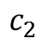

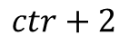
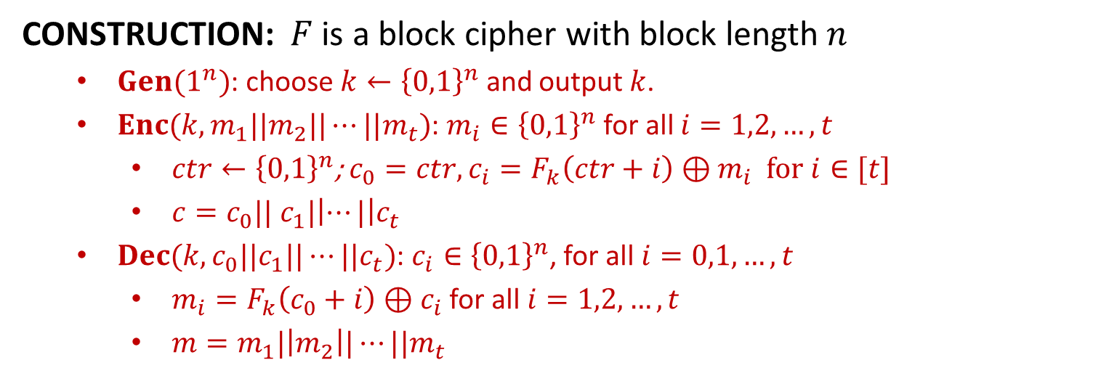
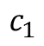

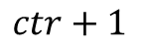
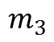
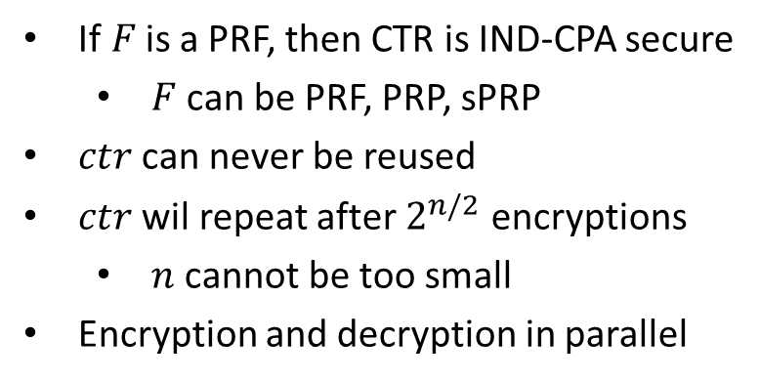
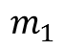
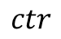
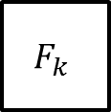
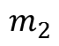
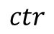
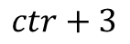

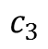

CTR
CONSTRUCTION: $F$ is a block cipher with block length $n$
$Gen(1^{n})$: choose $k←{\left\{0,1\right\}}^{n}$ and output $k$.
$Enc(k,m_{1}||m_{2}||⋯||m_{t})$: $m_{i}∈{\left\{0,1\right\}}^{n}$ for all $i=1,2,…,t$
$ctr←{\left\{0,1\right\}}^{n}$; $c_{0}=ctr, c_{i}=F_{k}\left(ctr+i\right)⊕m_{i}$ for $i∈[t]$
$c=c_{0}|| c_{1}|\left|⋯|\right|c_{t}$
$Dec(k,c_{0}||c_{1}||⋯||c_{t})$: $c_{i}∈{\left\{0,1\right\}}^{n}$, for all $i=0,1,…,t$
$m_{i}=F_{k}\left(c_{0}+i\right)⊕c_{i}$ for all $i=1,2,…,t$
$m=m_{1}|\left|m_{2}\right||⋯||m_{t}$
$$ctr$$
$$ctr+1$$
$$ctr+2$$
$$ctr+3$$
If$F$is a PRF, then CTR is IND-CPA secure
$F$ can be PRF, PRP, sPRP
$ctr$ can never be reused
$ctr$ wil repeat after $2^{n/2}$ encryptions
$n$ cannot be too small
Encryption and decryption in parallel
$$F_{k}$$
$$F_{k}$$
$$F_{k}$$
$$m_{1}$$
$$⨁$$
$$m_{2}$$
$$⨁$$
$$m_{3}$$
$$⨁$$
$$ctr$$
$$c_{1}$$
$$c_{2}$$
$$c_{3}$$

Slide 51
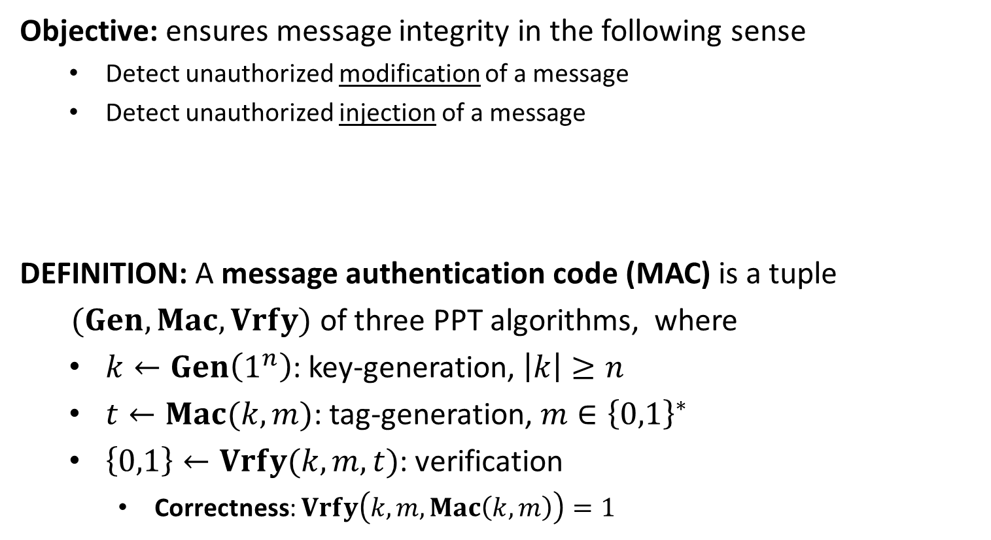
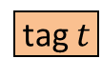
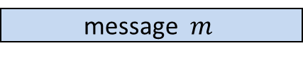
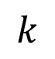
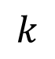
Message Authentication Code
Objective: ensures message integrity in the following sense
Detect unauthorized modification of a message
Detect unauthorized injection of a message
DEFINITION: A message authentication code (MAC) is a tuple
$(Gen, Mac,Vrfy)$ of three PPT algorithms, where
$k←Gen\left(1^{n}\right)$: key-generation, $\left|k\right|≥n$
$t←Mac(k,m)$: tag-generation, $m∈{\left\{0,1\right\}}^{∗}$
$\left\{0,1\right\}←Vrfy(k,m,t)$: verification
Correctness: $Vrfy\left(k,m,Mac\left(k,m\right)\right)=1$
message $m$
tag $t$
$$k$$
$$k$$

Slide 52
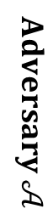
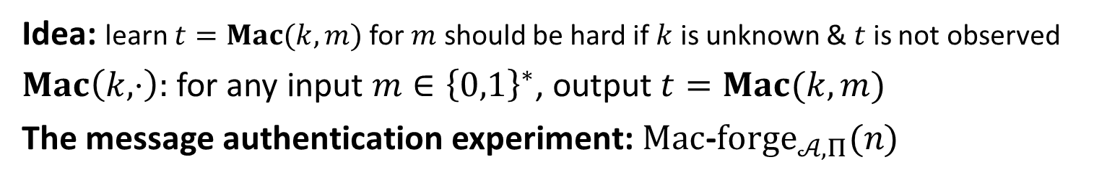

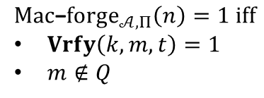
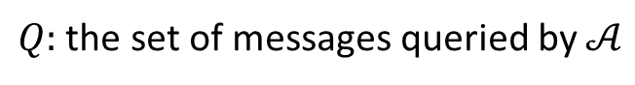
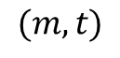
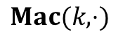
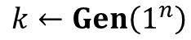
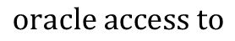
EUF-CMA
Idea: learn $t=Mac(k,m)$ for $m$ should be hard if $k$ is unknown & $t$ is not observed
$Mac\left(k,⋅\right):$ for any input $m∈{\left\{0,1\right\}}^{∗}$, output $t=Mac(k,m)$
The message authentication experiment: $Mac$-$forge_{𝒜,Π}(n)$
$$k←Gen\left(1^{n}\right)$$
$$oracle access to$$
$$Mac(k,⋅)$$
$$Challenger$$
$$Adversary 𝒜$$
$$(m,t)$$
$$Mac\text{−}forge_{𝒜,Π}\left(n\right)=1 iff$$
$Vrfy\left(k,m,t\right)=1$
$m∉Q$
$Q:$ the set of messages queried by $𝒜$

Slide 53
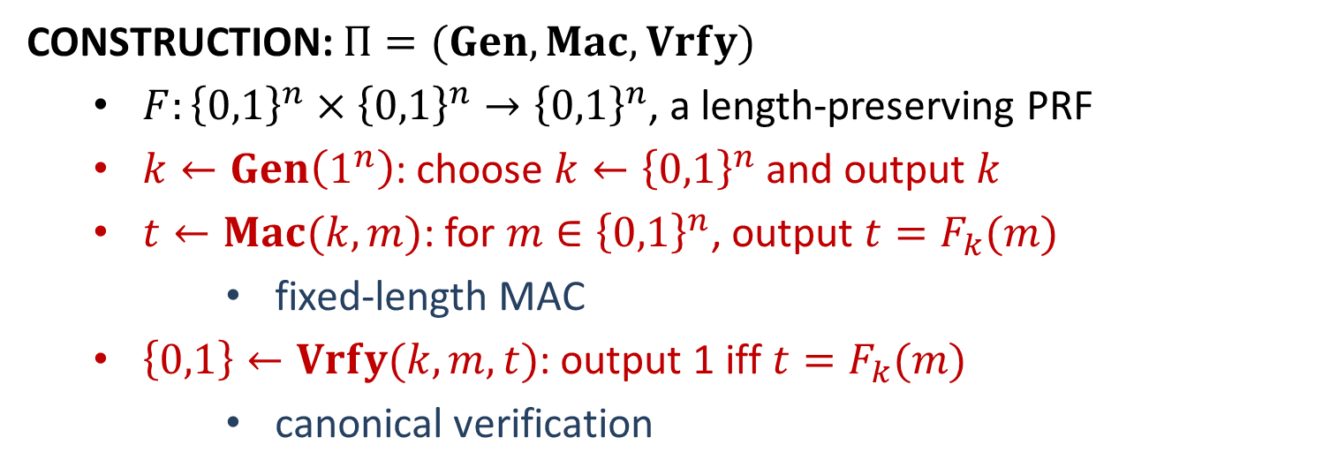
Fixed-Length MAC from PRF
CONSTRUCTION: $Π=(Gen, Mac,Vrfy)$
$F:{\left\{0,1\right\}}^{n}×{\left\{0,1\right\}}^{n}→{\left\{0,1\right\}}^{n}$, a length-preserving PRF
$k←Gen\left(1^{n}\right)$: choose $k←{\left\{0,1\right\}}^{n}$ and output $k$
$t←Mac(k,m)$: for $m∈{\left\{0,1\right\}}^{n}$, output $t=F_{k}(m)$
fixed-length MAC
$\left\{0,1\right\}←Vrfy(k,m,t)$: output 1 iff $t=F_{k}(m)$
canonical verification

Slide 54
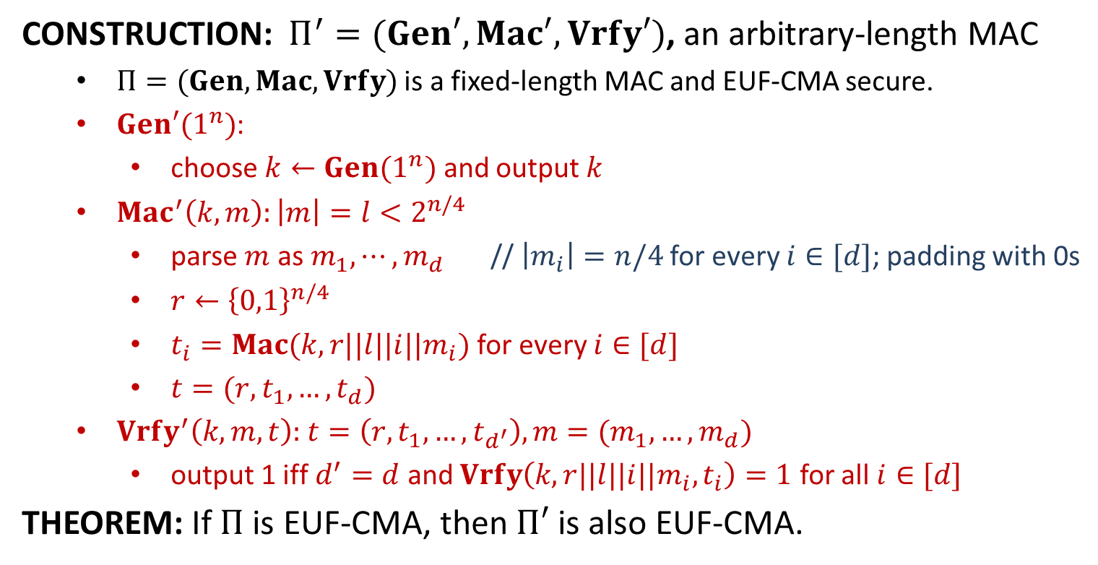
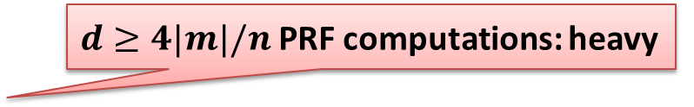

Arbitrary-Length MAC
CONSTRUCTION: $Π^{′}=(Gen′, Mac′,Vrfy′)$, an arbitrary-length MAC
$Π=(Gen, Mac,Vrfy)$ is a fixed-length MAC and EUF-CMA secure.
$Gen′(1^{n})$:
choose $k←Gen(1^{n})$ and output $k$
$Mac^{′}\left(k,m\right):\left|m\right|=l<2^{n/4}$
parse $m$ as $m_{1},⋯,m_{d}$ // $\left|m_{i}\right|=n/4$ for every $i∈[d]$; padding with 0s
$r←{\left\{0,1\right\}}^{n/4}$
$t_{i}=Mac(k,r||l||i||m_{i})$ for every $i∈[d]$
$t=(r,t_{1},…,t_{d})$
$Vrfy^{′}\left(k,m,t\right):$ $t=\left(r,t_{1},…,t_{d^{′}}\right), m=(m_{1},…,m_{d})$
output 1 iff $d^{′}=d$ and $Vrfy\left(k,r||l||i||m_{i}, t_{i}\right)=1$ for all $i∈[d]$
THEOREM: If $Π$ is EUF-CMA, then $Π′$ is also EUF-CMA.
$d≥4|m|/n$ PRF computations: heavy
$\left|t\right|>4|m|$: tag is too long

Slide 55
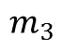
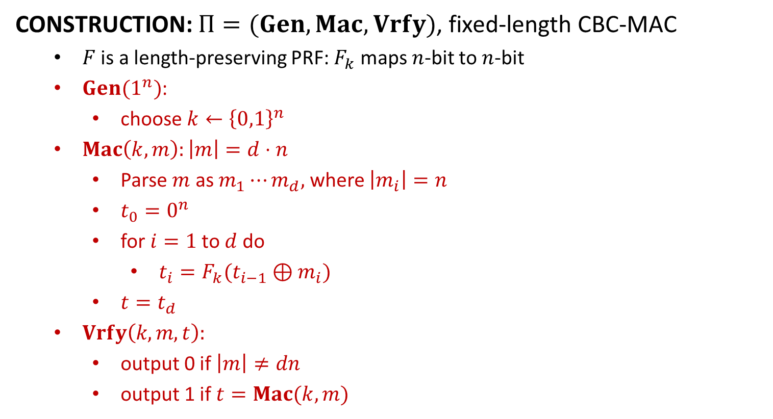
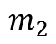
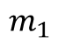

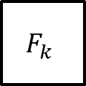


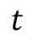
Fixed-Length CBC-MAC
CONSTRUCTION: $Π=(Gen, Mac,Vrfy)$, fixed-length CBC-MAC
$F$ is a length-preserving PRF: $F_{k}$ maps $n$-bit to $n$-bit
$Gen(1^{n})$:
choose $k←{\left\{0,1\right\}}^{n}$
$Mac\left(k,m\right):\left|m\right|=d⋅n$
Parse $m$ as $m_{1}⋯m_{d},$ where $\left|m_{i}\right|=n$
$t_{0}=0^{n}$
for$i=1$to$d$do
$t_{i}=F_{k}(t_{i−1}⊕m_{i})$
$t=t_{d}$
$Vrfy\left(k,m,t\right):$
output 0 if $\left|m\right|≠dn$
output 1 if $t=Mac(k,m)$
$$m_{1}$$
$$m_{2}$$
$$m_{3}$$
$$⨁$$
$$⨁$$
$$F_{k}$$
$$F_{k}$$
$$F_{k}$$
$$t$$

Slide 56
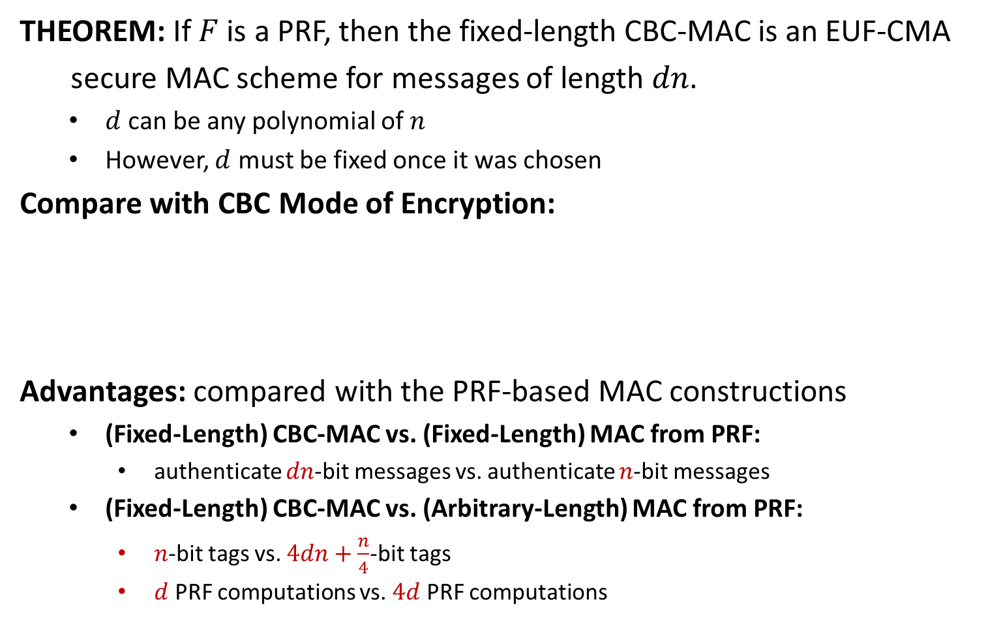
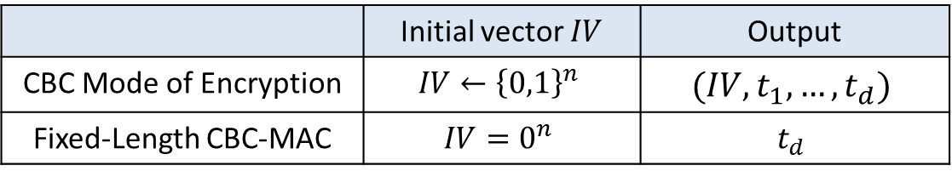
Fixed-Length CBC-MAC
THEOREM: If $F$ is a PRF, then the fixed-length CBC-MAC is an EUF-CMA
secure MAC scheme for messages of length $dn$.
$d$ can be any polynomial of $n$
However, $d$ must be fixed once it was chosen
Compare with CBC Mode of Encryption:
Advantages: compared with the PRF-based MAC constructions
(Fixed-Length) CBC-MAC vs. (Fixed-Length) MAC from PRF:
authenticate $dn$-bit messages vs. authenticate $n$-bit messages
(Fixed-Length) CBC-MAC vs. (Arbitrary-Length) MAC from PRF:
$n$-bit tags vs. $4dn+\frac{n}{4}$-bit tags
$d$ PRF computations vs. $4d$ PRF computations
 | Initial vector $IV$ | Output
CBC Mode of Encryption | $$IV←{\left\{0,1\right\}}^{n}$$ | $$(IV,t_{1},…,t_{d})$$
Fixed-Length CBC-MAC | $$IV=0^{n}$$ | $$t_{d}$$

Slide 57


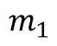
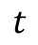
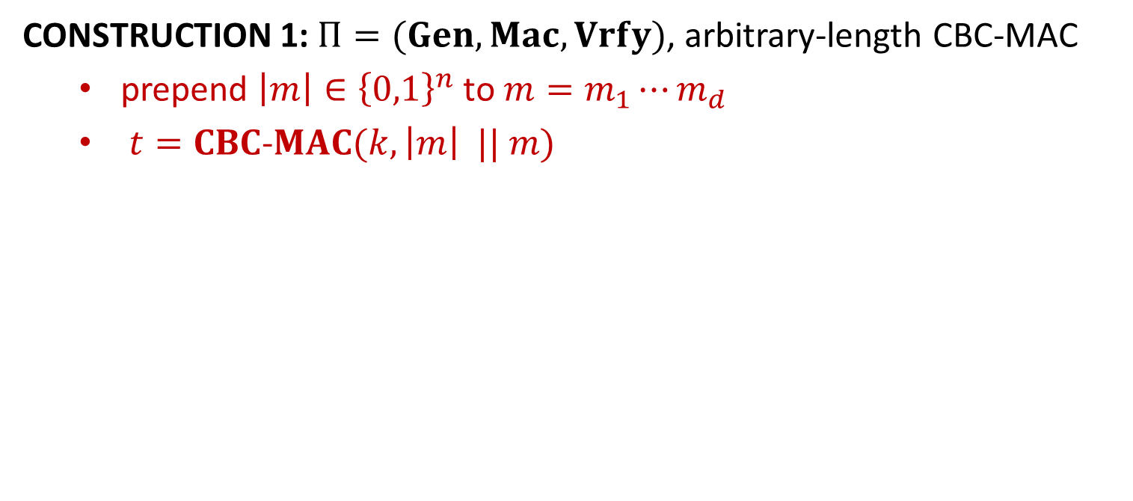




















Arbitrary-Length CBC-MAC
CONSTRUCTION 1: $Π=(Gen, Mac,Vrfy)$, arbitrary-length CBC-MAC
prepend $\left|m\right|∈{\left\{0,1\right\}}^{n}$ to $m=m_{1}⋯m_{d}$
$t=CBC$-$MAC(k, \left|m\right| || m)$
$$|m|$$
$$m_{1}$$
$$m_{2}$$
$$m_{3}$$
$$m_{1}$$
$$m_{2}$$
$$m_{3}$$
$$⨁$$
$$⨁$$
$$⨁$$
$$⨁$$
$$⨁$$
$$F_{k}$$
$$F_{k}$$
$$F_{k}$$
$$F_{k}$$
$$F_{k_{1}}$$
$$F_{k_{1}}$$
$$F_{k_{1}}$$
$$F_{k_{2}}$$
$$t$$
$$t$$
Construction 1
Construction 2
$$t^{′}$$
CONSTRUCTION 2: $Π=(Gen, Mac,Vrfy)$
choose $k_{1}, k_{2}←{\left\{0,1\right\}}^{n}$
$t=CBC$-$MAC\left(k_{1},m\right)$, $t^{′}=F_{k_{2}}(t)$

Slide 58

















$$\text{Chosen}\text{−}\text{Ciphertext} \text{Attack}$$
$Enc\left(k,⋅\right):$on any message $m∈ℳ$, output $c←Enc(k,m)$
$Dec\left(k,⋅\right):$on any ciphertext $c∈𝒞$, output $m←Dec(k,c)$
The CCA Indistinguishability Experiment $PrivK_{𝒜, Π}^{cca}(n)$
$$k←Gen\left(1^{n}\right)$$
$$oracle access to$$
$$Enc\left(k,⋅\right), Dec(k,⋅)$$
$$m_{0},m_{1}$$
$$\left|m_{0}\right|=|m_{1}|$$
$$Challenger$$
$$b←\{0,1\}$$
$$Adversary 𝒜$$
$$c←Enc(k,m_{b})$$
$$c$$
$$oracle access to$$
$$Enc\left(k,⋅\right), Dec(k,⋅)$$
$$b′$$
$$PrivK_{𝒜, Π}^{cca}(n)=\left\{\begin{aligned}0 b^{′}≠b \\ 1 b^{′}=b\end{aligned}\right.$$
Cannot query with $c$

Slide 59








sEUF-CMA
The Strong Message Authentication Experiment: $Mac$-$sforge_{𝒜,Π}(n)$
$$k←Gen\left(1^{n}\right)$$
$$orace access to$$
$$Mac(k,⋅)$$
$$Challenger$$
$$Adversary 𝒜$$
$$(m,t)$$
$$Mac\text{−}sforge_{𝒜,Π}\left(n\right)=1 iff$$
$Vrfy\left(k,m,t\right)=1$
$(m,t)∉Q$
$Q:$ the set of (message, tag) pairs queried by $𝒜$

Slide 60


IND-CPA+sEUF-CMA$⇒$ IND-CCA
CONSTRUCTION: $Π′=\left(Gen^{′}, Enc^{′}, Dec^{′}\right)+ℳ$//encrypt-then-authenticate
$Π_{E}=(Gen_{E}, Enc, Dec)$: an IND-CPA secure encryption
$Π_{M}=(Gen_{M}, Mac, Vrfy)$: a strong EUF-CMA secure MAC
$Gen^{′}(1^{n})$:
$k_{E}←Gen_{E}\left(1^{n}\right);k_{M}←Gen_{M}\left(1^{n}\right);$
Output $k=(k_{E},k_{M})$
$Enc′\left(k,m\right):m∈ℳ$
$c←Enc\left(k_{E},m\right), t=Mac(k_{M},c)$
Output $(c,t)$
$Dec′(k,(c,t))$:
If $Vrfy\left(k_{M}, c,t\right)=0$, output $⊥$;
Otherwise, output $m=Dec\left(k_{E},c\right)$
THEOREM: If $Π_{E}$ is IND-CPA and $Π_{M}$ is sEUF-CMA, then $Π′$ is IND-CCA.

Slide 61

(Cryptographic) Hash Function
Hash Table: hash functions in the course “data structures & algorithms”
$H: \{0,1\}^{∗}→\left[N\right]$ is a hash function -- store $x$ at location $H(x)$
look-up time: $O(1)$
collision: $x≠x^{′}, H\left(x\right)=H(x′)$
as few collisions as possible
DEFINITION: a hash function is a pair $Π=(Gen, H)$ of PPT algorithms
$s←Gen(1^{n})$: key generation
$H^{s}:{\left\{0,1\right\}}^{∗}→{\left\{0,1\right\}}^{l(n)}$
fixed-length for inputs of length $l′(n)$: $H^{s}$ is only defined on ${\left\{0,1\right\}}^{l^{′}(n)},$ where $l^{′}\left(n\right)>l(n)$
A fixed-length hash function is also called a compression function
The key $s$ is not private. It is public.

Slide 62






Collision Resistance
The Collision-Finding Experiment $Hash$-$coll_{𝒜,Π}(n)$:
$$s←Gen\left(1^{n}\right)$$
$$s$$
$$Challenger$$
$$Adversary 𝒜$$
$$x,x^{′}$$
$$Hash\text{−}coll_{𝒜,Π}\left(n\right)=1 iff$$
$$x≠x^{′}∧H^{s}\left(x\right)=H^{s}(x′)$$

Slide 63







Second-Preimage Resistance
The Second Preimage-Finding Experiment $Hash$-$Sec{Pre}_{𝒜,Π}(n)$:
$$s←Gen\left(1^{n}\right)$$
$$x←{\left\{0,1\right\}}^{l^{′}(n)}$$
$$s,x$$
$$Challenger$$
$$Adversary 𝒜$$
$$x^{′}$$
$$Hash\text{−}SecPre_{𝒜,Π}\left(n\right)=1 iff$$
$$x≠x^{′}∧H^{s}\left(x\right)=H^{s}(x′)$$
DEFINITION: $Π$is second Preimage resistant if for all PPT adversary $𝒜$
there is a negligible function $negl(⋅)$ such that
$\operatorname{Pr}\left[Hash\text{−}SecPre_{𝒜,Π}\left(n\right)=1\right] ≤negl(n)$,
where the probability is taken over all random coins in the
experiment.

Slide 64







Preimage Resistance
The Preimage-Finding Experiment $Hash$-${Pre}_{𝒜,Π}(n)$:
$$s←Gen\left(1^{n}\right)$$
$$y←{\left\{0,1\right\}}^{l(n)}$$
$$s,y$$
$$Challenger$$
$$Adversary 𝒜$$
$$x$$
$$Hash\text{−}Pre_{𝒜,Π}\left(n\right)=1 iff$$
$$H^{s}\left(x\right)=y$$
DEFINITION: $Π$is preimage resistant if for all PPT adversary $𝒜$ there is a
negligible function $negl(⋅)$ such that
$\operatorname{Pr}\left[Hash\text{−}Pre_{𝒜,Π}\left(n\right)=1\right] ≤negl(n)$,
where the probability is taken over all random coins in the
experiment.

Slide 65















Merkle-Damgård Transform
$$x_{1}$$
$$x_{2}$$
$$⋯$$
$$x_{B}$$
$$x_{B+1}=L$$
$$z_{0}$$
$$h^{s}$$
$$h^{s}$$
$$⋯$$
$$h^{s}$$
$$h^{s}$$
$$H^{s}\left(x\right)=z_{B+1}$$
$$z_{1}$$
$$z_{2}$$
$$z_{B}$$
CONSTRUCTION. $Π=\left(Gen′, H\right): {\left\{0,1\right\}}^{∗}→{\left\{0,1\right\}}^{n}$, arbitrary length hash
$Γ=\left(Gen,h\right):{\left\{0,1\right\}}^{2n}→{\left\{0,1\right\}}^{n}$, fixed-length hash
$Gen′(1^{n}):$ $s←Gen(1^{n})$
$H^{s}(x):$ $x∈{\left\{0,1\right\}}^{∗}, \left|x\right|=L<2^{n}$
$B=\left\lceil \frac{L}{n}\right\rceil$; pad $x$ (with 0s) to $x_{1}⋯x_{B}$ such that $\left|x_{i}\right|=n$ for every $i$
$x_{B+1}=L∈{\left\{0,1\right\}}^{n}$
$z_{0}=0^{n}$ // this can be arbitrary and fixed
$for i=1 to B+1$: $z_{i}=h^{s}\left(z_{i−1}||x_{i}\right)$
output $z_{B+1}$
Examples: MD5; SHA family

Slide 66

Hash-and-MAC
Arbitrary-Length MAC: two constructions have been studied
MAC from PRF: long tag; many PRF computations
CBC-MAC: short tag, had been industrial standard; not fast enough
CONSTRUCTION: $Π′=(Gen′,Mac′, Vrfy′)$, arbitrary-length MAC
$Π=(Gen, Mac, Vrfy)$, a fixed-length MAC for $l\left(n\right)$-bit messages
$Π_{H}=\left(Gen_{H}, H\right):{\left\{0,1\right\}}^{∗}→{\left\{0,1\right\}}^{l(n)}$, a hash function with output length $l(n)$
$Gen′(1^{n})$: choose $k←Gen\left(1^{n}\right), s←Gen_{H}(1^{n})$; output $k′=(k,s)$
$Mac′(k′,m)$: output $t=Mac(k, H^{s}(m))$
$Vrfy′(k′,m,t)$: output 1 iff $Vrfy\left(k,H^{s}\left(m\right),t\right)=1$
THEOREM: If the MAC scheme $Π$ is EUF-CMA and the has function $Π_{H}$ is
collision-resistant, then the new MAC scheme $Π′$ is EUF-CMA

Slide 67

Attacks of Hash Functions
QUESTION: Let $H:{\left\{0,1\right\}}^{∗}→{\left\{0,1\right\}}^{l}$ be a hash function with fixed length
digest. How to find a collision for $H$ in general?
Trivial Attack: compute $2^{l}+1$ digests; find collision
choose $q=2^{l}+1$ different messages $x_{1},…,x_{q}∈{\left\{0,1\right\}}^{∗}$
compute $y_{i}=H(x_{i})$ for all $i∈[q]$
Output a collision $(x_{i},x_{j})$
Probability of Success: 1
Complexity: $O(2^{l})$ hash computations
Birthday Attack: compute $O(2^{l/2})$ digests; find collision
choose $q$ distinct messages $x_{1},…,x_{q}←{\left\{0,1\right\}}^{∗}$
compute $y_{i}=H(x_{i})$ for all $i∈[q]$
check whether there exist $i,j∈[q]$ such that $y_{i}=y_{j}$

Slide 68

Attacks of Hash Functions
Solutions for the Birthday Problem: find the smallest number $q$
$Coll\left(q,365\right)≥\frac{1}{2}⇐\frac{q\left(q−1\right)}{4×365}≥\frac{1}{2}⇐q≥28$
$\prod_{i=1}^{q−1}{\left(1−\frac{i}{365}\right)}≤\frac{1}{2}⇐q≥23$
Birthday Attack of Hash Functions: find the smallest number $q$
$Coll\left(q,N\right)≥\frac{q\left(q−1\right)}{4N}≥\frac{1}{2}⇐q=\sqrt{2N}+1$ //require $N≥2$
$Coll\left(q,2^{l}\right)≥\frac{q\left(q−1\right)}{4⋅2^{l}}≥\frac{1}{2}⇐q=\sqrt{2}⋅2^{\frac{l}{2}}+1$ //require $l≥1$
$n$-bit security requires digest length $l≥2n$
Adversary runs in time $T⇒$ $\frac{l}{2}>\log{T}⇒l>2\log{T}$
necessary, not sufficient
On the Assumption: $\{H(x_{i})\}$ are uniform and independent?
If not independent, the attack performs better [Bellare, Kohno]

Slide 69












Feistel Network
$$L_{0}$$
$$R_{0}$$
Round $i:$ $\left(L_{i−1},R_{i−1}\right)→\left(L_{i},R_{i}\right)$
$L_{i}=R_{i−1}$
$R_{i}=L_{i−1}⊕f_{i}\left(R_{i−1}\right)$
$f_{i}:{\left\{0,1\right\}}^{l/2}→{\left\{0,1\right\}}^{l/2}$
$f_{i}\left(X\right)={\hat{f}}_{i}(k_{i},X)$ , round function
Inverse$:$ $\left(L_{i},R_{i}\right)→\left(L_{i−1},R_{i−1}\right)$
$R_{i−1}=L_{i}$
$L_{i−1}=R_{i}⊕f_{i}\left(L_{i}\right)$
Remarks: $f_{i}$ is either injective or not
Example: DES
$$f_{1}$$
$$L_{1}$$
$$R_{1}$$
$$f_{2}$$
$$L_{2}$$
$$R_{2}$$
$$f_{3}$$
$$L_{3}$$
$$R_{3}$$

Slide 70





















DES Encryption
$56$-bit
secret key $k$
key schedule
$48$-bit
$$k1$$
$$k2$$
$$⋯$$
$$k16$$
$$F(⋅,⋅)$$
$$F(⋅,⋅)$$
$$F(⋅,⋅)$$
$$m$$
$$IP$$
$$⋯$$
$$SW$$
$$IP^{−1}$$
$$c$$
$$L_{0},R_{0}$$
$$L_{1},R_{1}$$
$$L_{2},R_{2}$$
$$L_{16},R_{16}$$
$64$-bit
$64$-bit

Slide 71


















Key Schedule
64-bit key $K$
$$PC1$$
PC1
circular rotation of 1 bit to the
left to generate $k_{1},k_{2},k_{9},k_{16}$
circular rotation of 2 bits to the
left to generate other keys
28-bit
28-bit
<
<
28-bit
28-bit
PC2
48-bit $k1$
<
<
28-bit
28-bit
PC2
48-bit $k2$
64-bit $K→$ 56-bit $k$
<<
<<
$$PC2$$
28-bit
28-bit
PC2
48-bit $k3$
$$⋮$$
$$⋮$$
<
<
28-bit
28-bit
PC2
48-bit $k9$
<<
<<
28-bit
28-bit
PC2
48-bit $k10$
$$⋮$$
$$⋮$$
<
<
56-bit$→$48-bit
28-bit
28-bit
PC2
48-bit $k16$

Slide 72








$$F(k_{i},L_{i−1}||R_{i−1})$$
32-bit
32-bit
$$L_{i−1}$$
$R_{i−1}$
$$⊕$$
$L_{i}=R_{i−1}$
$R_{i}=L_{i−1}⊕\hat{f}\left(k_{i}, R_{i−1}\right)$
$\hat{f}:{\left\{0,1\right\}}^{48}×{\left\{0,1\right\}}^{32}→{\left\{0,1\right\}}^{32}$
$$\hat{f}(k_{i},⋅)$$
$L_{i}$
$R_{i}$

Slide 73


























The DES Mangler Function $\hat{f}(k_{i},⋅)$
$$32 bits$$
$$48 bits$$
$R_{i−1}$
$k_{i}$
$$E$$
$$48 bits$$
$$P$$
$$⊕$$
$$48 bits$$
$E$/ expansion function
$$S1$$
$$S2$$
$$S3$$
$$S4$$
$$S5$$
$$S6$$
$$S7$$
$$S8$$
$$32 bits$$
$$P$$
$$S3$$
$$\hat{f}(k_{i},R_{i−1})$$

Slide 74


$S$-Boxes and Mixing Permutations
$S$-boxes: $S_{1}, S_{2},…,S_{8}$
$S_{3}\left(a_{5}a_{4}a_{3}a_{2}a_{1}a_{0}\right)=$the $(a_{5}a_{0},a_{4}a_{3}a_{2}a_{1})$-entry of the table for $S_{3}$
Each box takes 6-bit blocks to 4-bit blocks and not invertible
Each box is a 4-to-1 function
Each row contains all 4-bit strings
Changing 1 bit of the input changes at least 2 bits of the output
Mixing Permutation:
The 4 bit output of each $S$-box affects 6 $S$-boxes in the next round

Slide 75

Double DES
CONSTRUCTION: $2E\left(\left(k_{1},k_{2}\right), m\right)=DES(k_{2},DES(k_{1},m))$
key length $2n$=112; block length $l$=64 //attack $2^{56}$
Meet-in-the-middle-attack:
Input: $(m,c)$, where $c=2E\left(\left(k_{1},k_{2}\right), m\right)$ for some $k_{1},k_{2}∈{\left\{0,1\right\}}^{56}$
Output: the key $(k_{1},k_{2})$
$L=L^{′}=∅$;
$for k_{1}∈{\left\{0,1\right\}}^{n} do: L=L∪\{(DES\left(k_{1},m\right),k_{1})\}$
$for k_{2}∈{\left\{0,1\right\}}^{n}$ $do: L′=L′∪\{(DES^{−1}\left(k_{2},c\right), k_{2})\}$
$S=\{\left(k_{1},k_{2}\right):DES\left(k_{1},m\right)=DES^{−1}\left(k_{2},c\right)\}$
Analysis:
$|S|$ is roughly equal to $2^{2n}/2^{l}$=$2^{2n−l}$; then apply exhaustive search
Complexity: time $O\left(n⋅2^{n}\right)+O(2^{2n−l})$, space: $O((n+l)⋅2^{n})$

Slide 76

Triple DES
CONSTRUCTIONs:
Triple-DES: $3E\left(\left(k_{1},k_{2},k_{3}\right), m\right)=DES(k_{3},DES^{−1}(k_{2},DES(k_{1},m)))$
key length=168/MIM attack $2112$
Triple-DES: $3E\left(\left(k_{1},k_{2}\right), m\right)=DES(k_{1},DES^{−1}(k_{2},DES(k_{1},m)))$
key length=112/attack $2112$
DESX: $EX\left(\left(k_{1},k_{2},k_{3}\right),m\right)=k_{1}⊕DES(k_{2},k_{3}⊕m)$
key length=184/attack $2120$
REMARKs:
1999, widely used today, slow, 2-key outdate
the new industrial standard is AES

Slide 77
Advanced Encryption Standard
The History of Advanced Encryption Standard (AES): FIPS 197
1997: NIST called for Advanced Encryption Standard
1998: 15 proposals were submitted/ the 1st AES workshop
1999: 5 submissions were selected/the 2nd AES workshop
2000: NIST adopted Rijndael (Belgium) /the 3rd AES workshop
The Basics of Advanced Encryption Standard (AES):
key length: 128-bit, 192-bit, or 256-bit
block length: 128-bit
number of rounds: 10, 12, 14
suitable for software & hardware implementations
key recovery attack: 4 times better than brute-force attack
substation-permutation network

Slide 78

Group
DEFINITION: A set $G$ and a binary operation $⋆$ on $G$ form a group if
Closure: $∀a,b∈G, a⋆b∈G$
Associative: $∀a,b,c∈G, a⋆\left(b⋆c\right)=\left(a⋆b\right)⋆c$
Identity element: $∃e∈G, ∀a∈𝔾, a⋆e=e⋆a=a$
Inverse: $∀a∈𝔾,∃b∈G$ such that $a⋆b=b⋆a=e$
DEFINITION: A group $(G,⋆)$ is called an Abelian group if
Commutative: $∀a,b∈G, a⋆b=b⋆a$
EXAMPLE: $\left(ℤ_{n},+\right)$ is an Abelian group //+ is addition of residue classes
Closure: $∀ {\left[a\right]}_{n},{\left[b\right]}_{n}∈ℤ_{n}, {\left[a\right]}_{n}+{\left[b\right]}_{n}={\left[a+b\right]}_{n}∈ℤ_{n}$
Associative: $∀{\left[a\right]}_{n},{\left[b\right]}_{n},{\left[c\right]}_{n}∈ℤ_{n}, {\left[a\right]}_{n}+\left({\left[b\right]}_{n}+{\left[c\right]}_{n}\right)={\left[a+b+c\right]}_{n}=\left({\left[a\right]}_{n}+{\left[b\right]}_{n}\right)+{\left[c\right]}_{n}$
Identity element: $∃{\left[0\right]}_{n}∈ℤ_{n}, ∀{\left[a\right]}_{n}∈ℤ_{n}, {\left[a\right]}_{n}+{\left[0\right]}_{n}={\left[0\right]}_{n}+{\left[a\right]}_{n}={\left[a\right]}_{n}$
Inverse: $∀{\left[a\right]}_{n}∈ℤ_{n},∃{\left[−a\right]}_{n}∈ℤ_{n}$ such that ${\left[a\right]}_{n}+{\left[−a\right]}_{n}={\left[−a\right]}_{n}+{\left[a\right]}_{n}={\left[0\right]}_{n}$
Commutative: $∀{\left[a\right]}_{n}, {\left[b\right]}_{n}∈ℤ_{n}, {\left[a\right]}_{n}+{\left[b\right]}_{n}={\left[a+b\right]}_{n}={\left[b+a\right]}_{n}={\left[b\right]}_{n}+{\left[a\right]}_{n}$

Slide 79

Subgroup
DEFINITION: Let $\left(G,⋆\right)$ be an Abelian group. A subset $H⊆G$ is called a
subgroup of $G$ if $\left(H,⋆\right)$ is also a group. $(H≤G)$
Multiplicative: $G=ℤ_{6}^{∗}=\left\{1,5\right\},H=\left\{1\right\}$
Additive: $G=ℤ_{6}=\left\{0,1,2,3,4,5\right\};H=\left\{0,2,4\right\}$
THEOREM: Let $(G,⋅)$ be an Abelian group. Let $〈g〉=\{g^{k}:k∈ℤ\}$ be a
subset of $G,$ where $g∈G$. Then $〈g〉≤G$.
Closure: $g^{a}⋅g^{b}=g^{a+b}∈〈g〉$
Associative: $g^{a}⋅\left(g^{b}⋅g^{c}\right)=g^{a+b+c}=\left(g^{a}⋅g^{b}\right)⋅g^{c}$
Identity element: $g^{0}⋅g^{a}=g^{a}⋅g^{0}=g^{a}$
Inverse: $g^{a}⋅g^{−a}=g^{−a}⋅g^{a}=g^{0}$
Communicative: $g^{a}⋅g^{b}=g^{a+b}=g^{b+a}=g^{b}⋅g^{a}$

Slide 80

Cyclic Group
DEFINITION: Let $(G,⋅)$ be an Abelian group. $G$ is said to be cyclic if
there exists $g∈G$ such that $G=〈g〉$.
$g$ is called a generator of $G$.
EXAMPLE: $ℤ_{10}^{∗}=\{{\left[1\right]}_{10},{\left[3\right]}_{10},{\left[7\right]}_{10},{\left[9\right]}_{10}\}$ $=〈{\left[3\right]}_{10}〉$
$g={\left[3\right]}_{10}$
$g^{0}={\left[1\right]}_{10}$, $g^{1}={\left[3\right]}_{10}, g^{2}={\left[9\right]}_{10}, g^{3}={\left[27\right]}_{10}={\left[7\right]}_{10}$
REMARK: Let $G$ be a finite group and let $g∈G$. Then $〈g〉$ can be
computed as $\{g^{1},g^{2},…\}$

Slide 81







Discrete Logarithm
Discrete Logarithm Experiment $DLog_{𝒜,𝒢}(n)$: $n$-the security parameter
DEFINITION: We say that the discrete logarithm problem is hard
relative to $𝓖$ if for all PPT algorithms $𝒜,$there is a negligible
function $negl$ such that
$$\operatorname{Pr}\left[DLog_{𝒜,𝒢}(n)=1\right]≤negl(n)$$
best known algorithm: $exp⁡(O({\left(\ln{q}\right)}^{1/3}{\left(\ln{\ln{q}}\right)}^{2/3}))$
$$\left(q,G,g\right)←𝒢\left(1^{n}\right)$$
$$h←G$$
$$(q,G,g,h)$$
$$x$$
if $g^{x}=h$, output 1;
otherwise, output 0.
challenger
$$𝒜$$

Slide 82







CDH
The CDH (Computational Diffie-Hellman) Experiment ${CDH}_{𝒜,𝒢}(n)$:
$$\left(q,G,g\right)←𝒢\left(1^{n}\right)$$
$$x,y←\left\{0,1,…,q−1\right\}$$
$$X=g^{x}, Y=g^{y}$$
$$(q,G,g,X,Y)$$
$$h$$
if $g^{xy}=h$, output 1;
otherwise, output 0.
challenger
$$𝒜$$
DEFINITION: We say that the CDH problem is hard relative to $𝓖$ if for all
PPT algorithms $𝒜,$there is a negligible function $negl$ such that
$\operatorname{Pr}\left[{CDH}_{𝒜,𝒢}(n)=1\right]≤negl(n)$
Best algorithm: via solving DLOG

Slide 83










DDH
The DDH (Decisional Diffie-Hellman) Experiment ${DDH}_{𝒜,𝒢}(n)$:
$$\left(q,G,g\right)←𝒢\left(1^{n}\right)$$
$$x,y,z←\left\{0,1,…,q−1\right\}$$
$$b←\{0,1\}$$
$$T=\left\{\begin{aligned}\left(g^{x}, g^{y},g^{xy}\right) b=0 \\ \left(g^{x},g^{y},g^{z}\right) b=1\end{aligned}\right.$$
$$(q,G,g,T)$$
$$b′$$
if $b^{′}=b$, output 1; otherwise, output 0.
challenger
$$𝒜$$
DEFINITION: We say that the DDH problem is hard relative to $𝓖$ if for all
PPT algorithms $𝒜,$there is a negligible function $negl$ such that
$\left|\operatorname{Pr}\left[{DDH}_{𝒜,𝒢}\left(n\right)=1\right]−\frac{1}{2}\right|≤negl(n)$
Best algorithm: via solving DLOG
DEFINITION: We say that the DDH problem is hard relative to $𝓖$ if for all
PPT algorithms $𝒜,$there is a negligible function $negl$ such that
$|\operatorname{Pr}\left[𝒜\left(q,G,g,g^{x},g^{y},g^{z}\right)=1\right]−Pr⁡[𝒜\left(q,G,g,g^{x},g^{y},g^{xy}\right)=1]|≤negl(n)$,
where $x,y,z←\{0,1,…,q−1\}$

Slide 84

Drawbacks of Private-Key
Key Distribution: the secret keys require secret communication
Physical meeting: need a key with every person (different places)
Trusted messenger service: not available to average person
Controller: IT manager (he knows too much keys)
Key Storage:
$N$ persons communicate: require $N(N−1)/2$secret keys
Each person share/store $N−1$ keys with other persons
$N$ may be very large $→$securely storing keys is hard (US embassy)

Slide 85








Key Exchange
DEFINITION: A key exchange protocol is a pair of interactive
(probabilistic polynomial-time) algorithms $Π$=(Alice, Bob)
The algorithms start with the security parameter $n$
The algorithms compute and send messages to each other
At the end, Alice outputs $k_{A}∈{\left\{0,1\right\}}^{n}$; Bob outputs $k_{B}∈{\left\{0,1\right\}}^{n}$
Correctness: $k_{A}=k_{B}$
Security: any other observer of the communication cannot learn $k_{A} (k_{B})$
The Key Exchange Experiment $KE_{𝒜,Π}^{eav}(n)$
$$\left(trans, k\right)←Π(n)$$
$$b←\{0,1\}$$
$b=0:\hat{k}=k$;
$$b=1:\hat{k}←{\left\{0,1\right\}}^{n}$$
$$(trans,\hat{k})$$
$$b′$$
$KE_{𝒜,Π}^{eav}\left(n\right)=\left\{\begin{aligned}0, b^{′}≠b \\ 1, b^{′}=b\end{aligned}\right.$
challenger
$$𝒜$$

Slide 86





Diffie-Hellman Key Exchange
CONSTRUCTION: $\left(q,G,g\right)←𝒢\left(1^{n}\right)$-the cyclic group generator
Alice: $\left(q,G,g\right)←𝒢\left(1^{n}\right)$; $x←ℤ_{q}, h_{A}=g^{x}$; send $\left(q,G,g,h_{A}\right)$ to Bob
Bob: $y←ℤ_{q}, h_{B}=g^{y}$; send $h_{B}$ to Alice; output $k_{B}=h_{A}^{y}$
Alice: output $k_{A}=h_{B}^{x}$
$\left(q,G,g\right)←𝒢\left(1^{n}\right)$
$x←ℤ_{q}$
$h_{A}=g^{x}$
output $k_{A}={\left(h_{B}\right)}^{x}$
$y←ℤ_{q}$
$h_{B}=g^{y}$
output $k_{B}={\left(h_{A}\right)}^{y}$
$$(q,G,g,h_{A})$$
$$h_{B}$$
Alice
Bob
Correctness: $h_{A}^{y}=g^{xy}=h_{B}^{x}⇒k_{A}=k_{B}$ (A, B output the same key)

Slide 87







Man-in-the-middle attack
Diffie-Hellman key exchange requires an authenticated channel:
Modification to the communication should be detectable.
Otherwise, there is a man-in-the-middle attack.
Man-in-the-middle attack: A and B output different keys (known to C)
$\left(q,G,g\right)←𝒢\left(1^{n}\right)$
$x←ℤ_{q}$
$h_{A}=g^{x}$
${k_{A}=\left(h_{C}\right)}^{x}$
$z←ℤ_{q}$
$h_{C}=g^{z}$
$k_{A}={\left(h_{A}\right)}^{z}$
$k_{B}={\left(h_{B}\right)}^{z}$
$y←ℤ_{q}$
$h_{B}=g^{y}$
${k_{B}=\left(h_{C}\right)}^{y}$
$$q,G,g,h_{A}$$
$$q,G,g,h_{C}$$
$$h_{B}$$
$$h_{C}$$
Alice
Charlie
Bob

Slide 88






Public-Key Encryption
$$m$$
$$Enc$$
$$c←Enc(pk, m)$$
$$Dec$$
Alice
Bob
$$pk$$
$$sk$$
$$Dec(sk, c)=m$$
$$Gen$$
$Gen, Enc, Dec$: key generation, encryption, decryption
$m, c, k$: plaintext (message), ciphertext, secret key
$ℳ,𝒞, 𝒦$ : plaintext space, ciphertext space, key space
$Π=(Gen, Enc, Dec)$ + $ℳ, \left|ℳ\right|>1$
Correctness: $Dec\left(sk,Enc\left(pk,m\right)\right)=m$ for any $pk,sk,m$

Slide 89

Comparisons
Private-Key Encryption:
$Enc$ and $Dec$ use the same key //symmetric-key encryption
$k$ must be secret
key distribution: physical meeting
key storage: $N(N−1)/2$ keys for $N$ users
1 sender, 1 receiver
bidirectional encryption
encryption speed: fast
Public-Key Encryption:
$Enc$ and $Dec$ use different keys //asymmetric-key encryption
$pk$ is public, $sk$ is secret
key distribution: make $pk$ public
key storage: $N$ public keys and $N$ private keys for $N$ users
many senders, 1 receiver
unidirectional encryption
encryption speed: 100-1000 times slower

Slide 90












IND-EAV
Let $Π=\left(Gen, Enc, Dec\right)+ℳ$ be a public-key encryption. Define an
eavesdropping indistinguishability experiment $PubK_{𝒜, Π}^{eav}(n)$
$$(pk,sk)←Gen\left(1^{n}\right)$$
$$pk$$
choose $m_{0}, m_{1}∈ ℳ$
with $\left|m_{0}\right|=|m_{1}|$
$$m_{0},m_{1}$$
$$b←\{0,1\}$$
$$Challenger$$
$$c←Enc(pk,m_{b})$$
$$Adversary 𝒜$$
$$c$$
$$b′$$
$$PubK_{𝒜, Π}^{eav}(n)=\left\{\begin{aligned}0 b^{′}≠b \\ 1 b^{′}=b\end{aligned}\right.$$

Slide 91













IND-CPA
IND-CPA experiment $PubK_{𝒜, Π}^{cpa}(n)$ for public-key encryption schemes
$$(pk,sk)←Gen\left(1^{n}\right)$$
$$pk$$
$$orace access to$$
$$Enc\left(pk,⋅\right)$$
$$m_{0},m_{1}$$
$$Challenger$$
$$\left|m_{0}\right|=|m_{1}|$$
$$Adversary 𝒜$$
$$b←\{0,1\}$$
$$c←Enc(pk,m_{b})$$
$$c$$
$$orace access to$$
$$Enc\left(pk,⋅\right)$$
$$b′$$
$$PubK_{𝒜, Π}^{cpa}(n)=\left\{\begin{aligned}0 b^{′}≠b \\ 1 b^{′}=b\end{aligned}\right.$$

Slide 92
IND-CPA
IND-CPA experiment $PubK_{𝒜, Π}^{cpa}(n)$ for public-key encryption schemes
$$(pk,sk)←Gen\left(1^{n}\right)$$
$$pk$$
$$m_{0},m_{1}$$
$$Challenger$$
$$\left|m_{0}\right|=|m_{1}|$$
$$Adversary 𝒜$$
$$b←\{0,1\}$$
$$c←Enc(pk,m_{b})$$
$$c$$
$$b′$$
$$PubK_{𝒜, Π}^{cpa}(n)=\left\{\begin{aligned}0 b^{′}≠b \\ 1 b^{′}=b\end{aligned}\right.$$

Slide 93

















IND-CCA
$Dec\left(sk,⋅\right):$given a ciphertext $c∈𝒞$, output $m←Dec(sk,c)$
IND-CCA experiment $PubK_{𝒜, Π}^{cca}(n)$
$$(pk,sk)←Gen\left(1^{n}\right)$$
$$pk$$
$$oracle access to$$
$$Dec(sk,⋅)$$
$$Challenger$$
$$m_{0},m_{1}$$
$$Adversary 𝒜$$
$$\left|m_{0}\right|=|m_{1}|$$
$$b←\{0,1\}$$
$$c←Enc(k,m_{b})$$
$$c$$
$$oracle access to$$
$$Dec(sk,⋅)$$
$$b′$$
$$PubK_{𝒜, Π}^{cca}(n)=\left\{\begin{aligned}0 b^{′}≠b \\ 1 b^{′}=b\end{aligned}\right.$$
Cannot query with $c$

Slide 94

ElGamal Encryption
CONSTRUCTION: $Π=\left(Gen,Enc,Dec\right)+ℳ$
$Gen(1n)$: $\left(q,G,g\right)←𝒢(1^{n})$; $x←ℤ_{q}, h=g^{x}$; output $pk=\left(q,G,g,h\right), sk=x$
$Enc(pk, m)$: $y←ℤ_{q}, c_{1}=g^{y}$; $c_{2}=m⋅h^{y}$; output $c=(c_{1},c_{2})$
$Dec(sk, c)$: output $c_{2}/c_{1}^{x}$
Correctness: $c_{2}/c_{1}^{x}=m⋅h^{y}/g^{yx}=m$
Basic Idea: use $k=g^{xy}$ as secret key in the generalized OTP
Security: IND-CPA assuming that DDH problem is hard
EXAMPLE: $q=10, G=ℤ_{11}^{∗};\left|G\right|=q$ and $g=2$
$x=3, pk=\left(10,ℤ_{11}^{∗},2, 2^{3}\right), sk=3$
$m=5, y=9, c=\left(2^{9}, {\left(2^{3}\right)}^{9}⋅5\right)=(6, 2)$
$m=2/6^{3}=2⋅8=5$

Slide 95

Plain RSA
CONSTRUCTION: $Π=\left(Gen,Enc,Dec\right)+ℳ,$the message space is
$ℳ=\{m:m∈\left[N\right],\gcd\left(m,N\right)=1\}$ //$ℳ=ℤ_{N}^{∗}$ in the textbook
$(pk, sk)←Gen$($1^{n}$)
choose two $n$-bit primes $p≠q;N=pq; φ\left(N\right)=\left(p−1\right)\left(q−1\right)$
${\left[e\right]}_{φ(N)}←ℤ_{φ\left(N\right)}^{∗};{\left[d\right]}_{φ(N)}={\left({\left[e\right]}_{φ\left(N\right)}\right)}^{−1}$//$0≤e, d<φ(N)$
output $pk=(N, e)$and $sk=(N, d)$
$c$ $←$ $Enc\left(pk, m\right):$ output $c=m^{e} mod N$ // $0≤c<N$
$m$ $←$ $Dec(sk, c)$ : output $m=c^{d} mod N$ //$0≤m<N$
Correctness: need to show that $Dec(sk, Enc\left(pk,m\right)=m$
$∃$ integer $t$ such that $ed=1+t⋅φ(N)$
${\left({\left[c\right]}_{N}\right)}^{d}={\left({\left[m^{e}\right]}_{N}\right)}^{d}={\left({\left({\left[m\right]}_{N}\right)}^{e}\right)}^{d}={\left({\left[m\right]}_{N}\right)}^{ed}={\left({\left[m\right]}_{N}\right)}^{1+tφ(N)}={\left[m\right]}_{N}$
${({\left[m\right]}_{N})}^{φ(N)}={\left[1\right]}_{N}$ // Euler’s Theorem
$m=c^{d} mod N$

Slide 96

Plain RSA
EXAMPLE: this is a toy example because all numbers are very small
$(pk, sk)←Gen$($1^{n}$)
$p=7, q=13,N=91$, $φ\left(N\right)=72$
$e=5, d=29$ //extended Euclidean algorithm
output $pk=(91, 5)$and $sk=(91, 29)$
$c$ $←$ $Enc(pk, m)$: $m=82$
output $c=({82}^{5} mod 91)=10$ //square-and-multiply
$m$ $←$ $Dec(sk, c)$: $c=10$
output $m=({10}^{29} mod 91)=82$ //square-and-multiply
How Large is the $N$ in practice?
$\left|N\right|=2048$ is recommended from present to 2030
$\left|N\right|=3072$ is recommended after 2030

Slide 97



RSA-OAEP
RSA Optimal Asymmetric Encryption Padding: Variant of padded RSA,
part of the RSA PKCS #1 since version 2.0
Encryption process:
$m∈{\left\{0,1\right\}}^{l}$
$G:{\left\{0,1\right\}}^{k_{0}}→{\left\{0,1\right\}}^{l+k_{1}}$
$H:{\left\{0,1\right\}}^{l+k_{1}}→{\left\{0,1\right\}}^{k_{0}}$
$\hat{m}=s||t$
$c={\left(\hat{m}\right)}^{e} mod N$
Security: IND-CCA under
RSA assumption
$l+k_{1}$ bits
$k_{0}$ bits
RSA Assumption: Given $N,e$ and $y←ℤ_{N}^{∗}$, it is hard to learn $x∈ℤ_{N}^{∗}$ such that $x^{e}=y$.

Slide 98







Digital Signature
DEFINITION: A digital signature scheme is a tuple $\left(Gen, Sign, Vrfy\right)$ of
three PPT algorithms:
$(pk,sk)←Gen\left(1^{n}\right)$: $pk,$ for verification; $sk,$ for signing
$σ←Sign\left(sk, m\right)$: signing algorithm; $σ$, signature of $m$
$\{0, 1\}←Vrfy\left(pk, (m,σ)\right)$: verification algorithm; 1, $σ$ is valid
Correctness: $Vrfy\left(pk, \left(m, Sign\left(sk,m\right)\right)\right)=1$ for $∀ m ∈ℳ$
$$(m, σ)$$
$$(m′, σ′)$$
$$?Vrfy\left(pk, \left(m, σ\right)\right)=1$$
Alice
Bob
Forgery: $\left(m′, σ′\right)$
$m′$ never signed by the holder of $sk$
$Vrfy\left(pk, \left(m′, σ′\right)\right)=1$
$$sk$$
A
$$pk$$

Slide 99






EUF-CMA
The Signature Experiment $Sig−forge_{𝒜,Π}(n)$
$$(pk,sk)←Gen\left(1^{n}\right)$$
$$pk$$
$$orace access to$$
$$Challenger$$
$$Sign(sk,⋅)$$
$$Adversary 𝒜$$
$$(m,σ)$$
$$output 1 if and only if$$
$m never signed with sk$
$Vrfy\left(pk,\left(m,σ\right)\right)=1$

Slide 100

Comparisons
The Security from Using Digital Signature:
data integrity: unauthorized modification of $m$ can be detected
without$sk$, it is hard to come up with $m^{′}≠m$ and its signature $σ′$
authenticity: any user of $pk$ can verify if he is talking with the user of $sk$
without$sk$, it is hard to come up with any $m^{′}$ and its signature $σ′$
Advantages of Using Digital Signature:
non-repudiation: the sender of $(m,σ)$ cannot deny
$Vrfy\left(pk, (m,σ)\right)$ means that $m$ has been signed by the holder of $sk$
key distribution: no physical meeting
key storage: $O(N)$ for $N$ people
Disadvantages of Using Digital Signature:
2 or 3 orders of magnitude slower than MACs

Slide 101

Plain RSA Signature
CONSTRUCTION: $Π=\left(Gen, Sign, Vrfy\right)+ℳ$, based on plain RSA
$(pk,sk)←Gen\left(1^{n}\right)$
Choose $\left(N,e,d\right)$ as in the key generation of RSA
$pk=(N, e)$and $sk=(N, d)$
$σ←Sign\left(sk, m\right)$: $m∈ℤ_{N}^{∗}$
$σ=(m^{d} mod N)$
$\{0, 1\}←Vrfy\left(pk, (m,σ)\right)$
output 1 if and only if $m=(σ^{e} mod N)$
Correctness: $σ^{e}≡{\left(m^{d}\right)}^{e}≡m^{de}≡m^{1}≡m (mod N)$
Security: plain RSA signature is not EUF-CMA
No query attack:
Input: $pk=(N,e)$
Choose $σ← ℤ_{N}^{∗}$. Compute $m=(σ^{e} mod N)$
Output: $(m, σ)$

Slide 102

RSA-FDH
CONSTRUCTION: $Π=\left(Gen, Sign, Vrfy\right)+{\left\{0,1\right\}}^{∗}$, plain RSA sig + FDH
$(pk,sk)←Gen\left(1^{n}\right)$
Choose $\left(N,e,d\right)$ as in the key generation of RSA
choose a function $H: {\{0,1\}}^{∗}→$ $ℤ_{N}^{∗}$ (modeled as a random oracle)
$pk=(N, e, H)$and $sk=(N, d,H)$
$σ←Sign\left(sk, m\right):m∈{\left\{0,1\right\}}^{∗}$
$σ=({H\left(m\right)}^{d} mod N)$
$\{0, 1\}←Vrfy\left(pk, (m,σ)\right)$
output 1 if and only if $H\left(m\right)=(σ^{e} mod N)$
Correctness: $σ^{e}≡{\left({H\left(m\right)}^{d}\right)}^{e}≡{H\left(m\right)}^{de}≡{H\left(m\right)}^{1}≡H\left(m\right) \left(mod N\right)$
$H\left(m\right)=(σ^{e} mod N)$
THEOREM: If the RSA problem is hard and$H$is modeled as a random
oracle, then RSA-FDH is EUF-CMA.

Slide 103

Hash-and-Sign
CONSTRUCTION: $Π′\text{=}(Gen′, Sign′, Vrfy′)\text{+}{\{0,1\}}^{∗}$
$Π\text{=}\left(Gen, Sign, Vrfy\right)+{\left\{0,1\right\}}^{l(n)}$ , a signature scheme for $l(n)$-bit messages
$Π_{H}\text{=}({Gen}_{H},H)$: ${\{0,1\}}^{∗}→{\left\{0,1\right\}}^{l(n)},$ a hash function
$(PK,SK)←Gen′\left(1^{n}\right)$
$\left(pk,sk\right)←Gen(1^{n})$; $s←{Gen}_{H}(1^{n})$
$PK=(pk, s)$and $SK=(sk, s)$
$σ←Sign′\left(SK, m\right)$: $m ∈{\{0,1\}}^{∗}$
output $σ←Sign (sk, H^{s}(m))$
$\{0, 1\}←Vrfy′\left(PK, (m,σ)\right)$
output 1 iff $Vrfy\left(pk, \left(H^{s}\left(m\right), σ\right)\right)=1$
THEOREM: If $Π$ is EUF-CMA for messages of length$l$and $Π_{H}$ is collision
resistant, then $Π^{′}$ is EUF-CMA.
Proof: similar to hash-and-MAC

Slide 104
Beyond Secure Communication
Secure Communication: confidentiality + integrity
There are two parties, Alice and Bob, who want to communicate securely.
Confidentiality: private communication channel
Integrity: authenticated communication channel
There is an adversary Charlie, who may wiretap or modify the channel.
Countermeasures:
PrivKE and PubKE: confidentiality
MAC and SIG: Integrity
Secure Computation: confidentiality + integrity
There are two parties, Alice and Bob, who are communicating securely.
Alice (or Bob) may be an adversary and try to learn more information about Bob (or Alice) than what he is authorized to learn.

Slide 105

Multi-Party Computation
$n$-Party Computation Problem:
There are $n$ parties: $P_{1},$ $P_{2}$……, $P_{n}$; Each party $P_{i}$ has an input $x_{i}$ ($i∈ [n]$)
There is a public function $f:{\left\{0,1\right\}}^{∗}×⋯×{\left\{0,1\right\}}^{∗}→{\left\{0,1\right\}}^{∗}×⋯×{\left\{0,1\right\}}^{∗}$
$f\left(x_{1},x_{2},…,x_{n}\right)=\left(f_{1}\left(x_{1},x_{2},…,x_{n}\right), …, f_{n}\left(x_{1},x_{2},…,x_{n}\right)\right)$
For every $i∈[n]$, each party $P_{i}$ wants to learn $f_{i}\left(x_{1},x_{2},…,x_{n}\right)$
For every $i∈[n]$, each party $P_{i}$ wants to keep $x_{i}$ secret from all other parties
Millionaires’ Problem: a two-party computation problem
There are two parties: Alice and Bob; Alice has $x$; Bob has $y$.
There is a public function $f\left(x,y\right)=\left(GE\left(x,y\right), GE\left(x,y\right)\right)$.
Both Alice and Bob want to learn the value of $GE\left(x,y\right)$.
Alice wants to keep $x$secret; Bob wants to keep $y$ secret.

Slide 106













Oblivious Transfer
1-out-of-2 Oblivious Transfer Problem: $f(\left(s_{0},s_{1}\right),i)=(⊥,s_{i})$
EGL Construction: proposed by Even, Goldreich, and Lempel in 1982
Building block $Π=(Gen, Enc, Dec)+ℳ$: a public-key encryption scheme
Alice’s input: $s_{0},s_{1}∈ℳ$; Bob’s input: $i∈\{0,1\}$
$$s_{0},s_{1}$$
$$i∈\{0,1\}$$
$$⋮$$
$$s_{i}$$
Alice
Bob
Correctness: If both parties are honest, Alice learns nothing, Bob learns $s_{i}$
Security: Bob may run $\left(pk_{0},sk_{0}\right)←Gen\left(1^{n}\right)$ and $\left(pk_{1},sk_{1}\right)←Gen\left(1^{n}\right)$
He can learn both $s_{0}$ and $s_{1}$
$$s_{0},s_{1}$$
$$x_{0}=Enc\left(pk_{0},s_{0}\right)$$
$$x_{1}=Enc(pk_{1}, s_{1})$$
$\left(pk_{i},sk_{i}\right)←Gen\left(1^{n}\right)$
choose $pk_{1−i}$ randomly
$s_{i}=Dec(sk_{i},x_{i})$
$$i∈\{0,1\}$$
$$(pk_{0},pk_{1})$$
$$(x_{0},x_{1})$$
$$s_{i}$$
Alice
Bob

Slide 107









Bellare-Micali Construction
The Construction: Bob proves that he only knows one of the $sk_{0},sk_{1}$
Alice’s input: $s_{0},s_{1}$; Bob’s input: $i∈\{0,1\}$
$$s_{0},s_{1}$$
$\left(q,G,g\right)←𝒢(1^{n})$
$c←G$
$r_{0},r_{1}←ℤ_{q}$
$x_{0}=(g^{r_{0}}, H\left(pk_{0}^{r_{0}}\right)⊕s_{0})$
$x_{1}=(g^{r_{1}}, H\left(pk_{1}^{r_{1}}\right)⊕s_{1})$
$k←ℤ_{q}$
$pk_{i}=g^{k}$
$pk_{1−i}=c/g^{k}$
$x_{i}=(a,b)$
$s_{i}=H\left(a^{k}\right)⊕b$
$$i∈\{0,1\}$$
$$(q,G,g,c)$$
$$({pk}_{0},{pk}_{1})$$
$$(x_{0},x_{1})$$
$$s_{i}$$
Correctness: If both parties are honest, Alice learns nothing, Bob learns $s_{i}$
Security: Bob cannot learn both $\log_{g}{pk_{0}}$ and $\log_{g}{pk_{1}}$, unless he can solve DLOG
As $\log_{g}{pk_{1−i}}$ is unknown, $x_{1−i}$ looks random for Bob
Alice
Bob

Slide 108


(1) Alice: $f$ $→$ Boolean circuit $BC(f)$
$$GE\left(x,y\right)=\left(¬b_{1}∧a_{1}\right)∨\left(¬\left(b_{1}∧¬a_{1}\right)∧¬\left(b_{0}∧¬a_{0}\right)\right)$$
$$1$$
$$2$$
$$3$$
$$4$$
$$5$$
$$6$$
$$7$$
$$8$$
$$9$$
$$10$$
$$11$$
$$12$$
$$13$$
$$14$$
$$15$$
$$16$$
$$GE(x,y)$$

Slide 109


(2) Alice: $BC(f)→$garbled circuit $GC(f)$
Special Private-Key Encryption: $Π=\left(Gen,Enc, Dec\right)+ℳ$
Elusive Range: for any PPT adversary $𝒜$, there is a negligible function $negl()$
$$\operatorname{Pr}\left[k←Gen\left(1^{n}\right): 𝒜\left(1^{n}\right)∈Range_{n}\left(k\right)\right]≤negl(n)$$
$Range_{n}\left(k\right)=\{Enc\left(k,m\right):m∈ℳ\}$
Efficiently verifiable range: there is a PPT algorithm $M$ such that
$M\left(1^{n},k,c\right)=1$ if and only if $c∈Range_{n}\left(k\right)$
For every $c∉Range_{n}\left(k\right)$, $Dec\left(k,c\right)=⊥$
Construction of the special PrivKE: $Enc\left(k,m\right)=\left(r,F_{k}\left(r\right)⊕\left(x||0^{n}\right)\right)$
$F:{\left\{0,1\right\}}^{n}×{\left\{0,1\right\}}^{n}→{\left\{0,1\right\}}^{2n}$ is a PRF
The Transformation:
For each wire $w$ in $BC(f)$, choose two labels (secret keys of $Π$) $k_{w}^{0}, k_{w}^{1}$
For $i=0,1,$ $k_{w}^{i}$ means that the value on $w$ is $i$
For each gate $g$ in $BC(f)$, convert $g$ to a garbled gate $GC(g)$, which is a table
For each gate $g$ in $BC(f)$, assign a random permutation to permute $GC(g)$
$GC\left(f\right)=$all permuted tables
Output: labels of input wires, labels of output wires, and $GC\left(f\right)$

Slide 110


(2) Alice: $BC(f)→$garbled circuit $GC(f)$
$$GC(g)$$
AND gate $g$
Choose labels
Encrypted gate
Permuted Encrypted gate
Truth table

Slide 111


(2) Alice: $BC(f)→$garbled circuit $GC(f)$
$$GC(g)$$
OR gate $g$
Choose labels
Encrypted gate
Permuted Encrypted gate
Truth table

Slide 112


(2) Alice: $BC(f)→$garbled circuit $GC(f)$
$$GC(g)$$
NOT gate $g$
Choose labels
Encrypted gate
Permuted Encrypted gate
Truth table

Slide 113



(3) Alice: Send $GC(f)$ and input labels to Bob
The garbiled circuit $GC(f)$ consists of
Permutated encrypted tables: 10 tables in our example
The input labels for Alice’s inputs: $k_{3}^{a_{1}},$ $k_{4}^{a_{1}}, k_{6}^{a_{0}}$
(4) Bob: Collect input labels from Alice
The input labels for Bob’s inputs: $k_{1}^{b_{1}},$ $k_{2}^{b_{1}}, k_{5}^{b_{0}}$
Bob needs to run 1 out of 2 OT with Alice
Alice is the sender
Bob is the chooser

Slide 114
(5) Bob: Evaluate the Garbled Circuit
Bob: decrypt the permuted encrypted table with ${(k_{u}^{a}, k}_{v}^{b})$
Bob: decrypt the permuted encrypted table with $k_{u}^{a}$
Bob: only one of the decryption is successful
Bob: the successful decryption gives $k_{w}^{g(a,b)}$
Bob: the decryption is done until the output wire is reached
Bob: send the output label to Alice
(6) Alice: Convert the output label to output

Slide 115

















2-Party Computation of $GE(x,y)$
$$(k_{2}^{0},k_{2}^{1})$$
$$(k_{4}^{0},k_{4}^{1})$$
$$(k_{6}^{0},k_{6}^{1})$$
$$(k_{1}^{0},k_{1}^{1})$$
$$(k_{3}^{0},k_{3}^{1})$$
$$(k_{5}^{0},k_{5}^{1})$$
$$(k_{8}^{0},k_{8}^{1})$$
$$(k_{9}^{0},k_{9}^{1})$$
$$(k_{7}^{0},k_{7}^{1})$$
$$(k_{10}^{0},k_{10}^{1})$$
$$(k_{11}^{0},k_{11}^{1})$$
$$(k_{12}^{0},k_{12}^{1})$$
$$(k_{13}^{0},k_{13}^{1})$$
$$(k_{14}^{0},k_{14}^{1})$$
$$(k_{15}^{0},k_{15}^{1})$$
$$(k_{16}^{0},k_{16}^{1})$$

Slide 116







Delegating Computation
$x, f, f(x)$are all disclosed to Bob!
$$x=(x_{1},x_{2},…,x_{n})$$
$$f$$
$$y=f(x)$$
Alice
Bob
A Naive Scenario for Delegating Computation:
Alice has a weak device such as a smart phone, a netbook, a sensor, …
slow CPU, limited storage, limited power
Alice may collect a lot of data ($x_{1},x_{2},…,x_{n}$) every day
Due to limited storage, Alice stores the data (denoted as $x$) on a cloud (Bob)
Alice may want to learn $f(x)$, e.g., sum, mean, variance, …
Alice downloads $x$ and computes $f(x)$?
Too much data! Too heavy computation!
Bob can compute $y=f(x)$ and send it to Alice

Slide 117













Homomorphic Encryption
DEFINITION: A public-key encryption $Π=\left(Gen,Enc,Dec\right)+ℳ$ is
additively homomorphic if there is an operation $⊞$ over the
ciphertext space of $Π$ such that for any $\left(pk,sk\right)←Gen(1^{n})$,
any $m_{1},m_{2}∈ℳ$, any $c_{1}←Enc\left(pk,m_{1}\right), c_{2}←Enc(pk,m_{2})$,
the following identity holds:
$$Dec\left(sk, c_{1}⊞c_{2}\right)=m_{1}+m_{2}.$$
$$c_{1}$$
$$m_{1}$$
$$m_{1}$$
$$m_{1}+m_{2}$$
$$Dec$$
$$Enc$$
$$⊞$$
$$m_{1}+m_{2}$$
$$m_{2}$$
$$m_{2}$$
$$c_{2}$$
$$c_{1}⊞c_{2}$$

Slide 118

Paillier’s Encryption
CONSTRUCTION: $Π=\left(Gen,Enc,Dec\right)+ℳ, ℳ=ℤ_{N}$
$(pk, sk)←Gen$($1^{n}$)
choose two $n$-bit primes $p≠q;N=pq$
output $pk=N$and $sk=(p,q)$
$c$ $←$ $Enc\left(pk, m\right):$ $m∈ℤ_{N}$
choose $r←ℤ_{N}^{∗}$;
output $c={\left(1+N\right)}^{m}⋅r^{N} mod N^{2}$
$m$ $←$ $Dec(sk, c)$ : $φ\left(N\right)=(p−1)(q−1)$
$α=(c^{φ\left(N\right)} mod N^{2})−1$;
$β=α/N$;
compute $γ$ such that $γ⋅φ(N)≡1 (mod N^{2})$
output $β⋅γ mod N$

Slide 119

Homomorphic Property
THEOREM: Paillier encryption is IND-CPA secure if the decisional
composite residuosity problem is hard.
decisional composite residuosity problem: given an integer $N=pq$, distinguish between the following distributions:
$X=(r^{N} mod N^{2})$, where $r←ℤ_{N^{2}}^{∗}$
$Y=r$, where $r←ℤ_{N^{2}}^{∗}$
Proof is omitted from this lecture
Homomorphic Addition: by multiplying two ciphertexts
$c_{1}={\left(1+N\right)}^{m_{1}}r_{1}^{N} mod N^{2}$
$c_{2}={\left(1+N\right)}^{m_{2}}r_{2}^{N} mod N^{2}$
$c_{1}⊞c_{2}=c_{1}⋅c_{2} mod N^{2}={\left(1+N\right)}^{m_{1}+m_{2}}{\left(r_{1}r_{2}\right)}^{N} mod N^{2}$
$Dec\left(sk,c_{1}⊞c_{2}\right)=m_{1}+m_{2} mod N$
$c_{1}⊞c_{2}$ is a ciphertext of $m_{1}+m_{2} mod N$

Slide 120

Homomorphic Property
Homomorphic Scalar Multiplication: by exponentiating a ciphertext
$c={\left(1+N\right)}^{m}r^{N} mod N^{2}$
Is it possible to compute a ciphertext of $2m mod N=m+m$ $mod N$?
$c^{2}=c⋅c mod N^{2}={\left(1+N\right)}^{m+m}{\left(r^{2}\right)}^{N} mod N^{2}$
$Dec\left(sk,c^{2}\right)=2m mod N$
$c^{2}$ is a ciphertext of $2m mod N$
Homomorphic Linear Combination:
$c_{1}={\left(1+N\right)}^{m_{1}}r_{1}^{N} mod N^{2}$
$c_{2}={\left(1+N\right)}^{m_{2}}r_{2}^{N} mod N^{2}$
Is it possible to compute a ciphertext of $2m_{1}+3m_{2} mod N$?
$2m_{1}+3m_{2} mod N=m_{1}+m_{1}+m_{2}+m_{2}+m_{2} mod N$
$c_{1}^{2}⋅c_{2}^{3}=c_{1}⋅c_{1}⋅c_{2}⋅c_{2}⋅c_{2} mod N^{2}={\left(1+N\right)}^{m+m}{\left(r^{2}\right)}^{N} mod N^{2}$
$Dec\left(sk,c_{1}^{2}⋅c_{2}^{3}\right)=2m_{1}+3m_{2} mod N$
$c_{1}^{2}⋅c_{2}^{3}$ is a ciphertext of $2m_{1}+3m_{2} mod N$

